Slide 1
Hazard Communication
Globally Harmonized System-GHS

Slide 2
Purpose
Ensure chemical safety in the workplace
OSHA's Hazard Communication Standard requires the development and dissemination of information about the identities and hazards of the chemicals must be available and understandable to workers.

Slide 3
WORKER RIGHTS UNDER OSH ACT
Workers are entitled to safe and healthful conditions. The OSH ACT provides workers with the right to:
Ask OSHA to inspect their workplace;
Review employers’ records of work-related injuries and illnesses
Get copies of their medical records; and
Receive information and training about hazards and their prevention, using applicable OSHA standards.
Notes:
Workers are entitled to working conditions that do not pose a risk of serious harm to them. To help ensure a safe and healthful workplace, the OSH Act provides workers with the right to ask OSHA to inspect their workplace; use their rights under the law without retaliation and discrimination; receive information and training about hazards, and the methods for prevention. Under the OSH Act, workers also have the right to ask for the OSHA standards that apply to their workplace, get copies of test results regarding the hazards in the workplace, review records of work-related injuries and illnesses, and get copies of their medical records.

Slide 4
RIGHT-TO-KNOW
Federal Hazard Communication Standard, Title 29, Part 1910.1200 of the Code of Federal Regulations (29 CFR 1910.1200) mandates that “Workers have the right to know and understand the hazardous chemicals they use and how to work with them safely.”
This regulation is designed to make information about hazardous chemicals that are present in work places available to exposed employees.
The hazard communication standard applies to any business, including manufacturers that use hazardous chemicals, regardless of the number of individuals employed.
Notes:
Federal Hazard Communication Standard, Title 29, Part 1910.1200 of the Code of Federal Regulations (29 CFR 1910.1200) mandates that “Workers have the right to know and understand the hazardous chemicals they use and how to work with them safely.” This regulation is designed to make information about hazardous chemicals that are present in work places available to exposed employees. The hazard communication standard applies to any business, including manufacturers that use hazardous chemicals, regardless of the number of individuals employed.

Slide 5
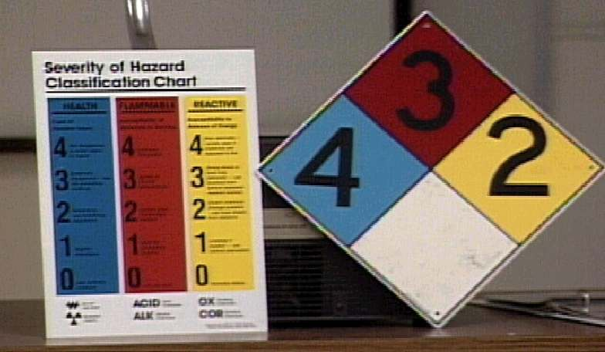
The Standard Responsibilities
Chemical Manufacturers- Must determine the physical and health hazards of the products they make and provide that information to users.
Employers- Must determine which workplace materials are hazardous and provide employees with the information, training, and equipment they need to protect themselves and others. Must determine which workplace materials are hazardous and provide employees with the information, training, and equipment they need to protect themselves and others.
Employees-Must use their Right-to-Know knowledge to stay safe and healthy on the job. Must use their Right-to-Know knowledge to stay safe and healthy on the job.

Slide 6
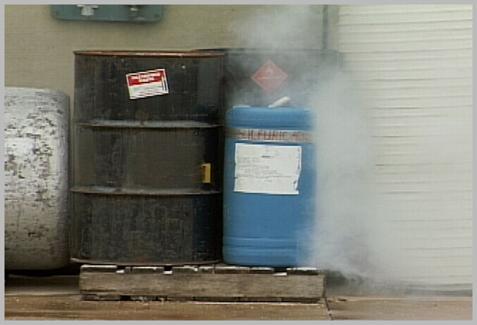
What do you know?
Chemicals have many valuable uses and are used often.
Many chemicals also have hazards that can present risks to health and safety when they are used on the job.

Slide 7
Chemical Hazards
Health Hazards
Acute Toxicity
Skin corrosion/irritation
Carcinogencity
ROUTES OF ENTRY
Inhalation
Ingestion
Injection
Skin Contact or Absorption
Physical Hazards
Sudden release of pressure (explosion)
Flammable (catches fire easily)
Reactive (unstable chemicals)
Notes:
Health Hazards are associated with chemicals which pose hazardous effects, such as skin corrosion/irritation, carcinogenicity and acute toxicity.
Physical hazards are those which threaten employees’ physical safety, such as flammable gases, explosives, and gases under pressure .

Slide 8
What is GHS?
The Globally Harmonized System (GHS) is an international approach to chemical labels and safety data sheets (SDS).
OSHA’s Hazard Communication standard has adopted the GHS to improve safety and health of workers through more effective communications on chemical hazards.

Slide 9
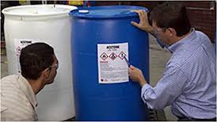
Labeling
Every container of hazardous chemicals is labeled by the manufacturer.
Labels make it easy to find at a glance the chemical’s possible hazards and basic steps to take to protect yourself against those risks.
Labels must have:
Product identifier
Symbols (Hazard pictograms)
Signal word
Hazard statement(s)
Precautionary statement(s)
Name, address, phone number of manufacturer, importer or responsible party
Notes:
Labels must follow a specific format under GHS. It is required that a label include a product identifier which shows how the hazardous chemical is identified, such as chemical name,
code number or batch number; pictograms; signal words; precautionary statements; and name, address, phone number of manufacturer, importer or responsible party.

Slide 10
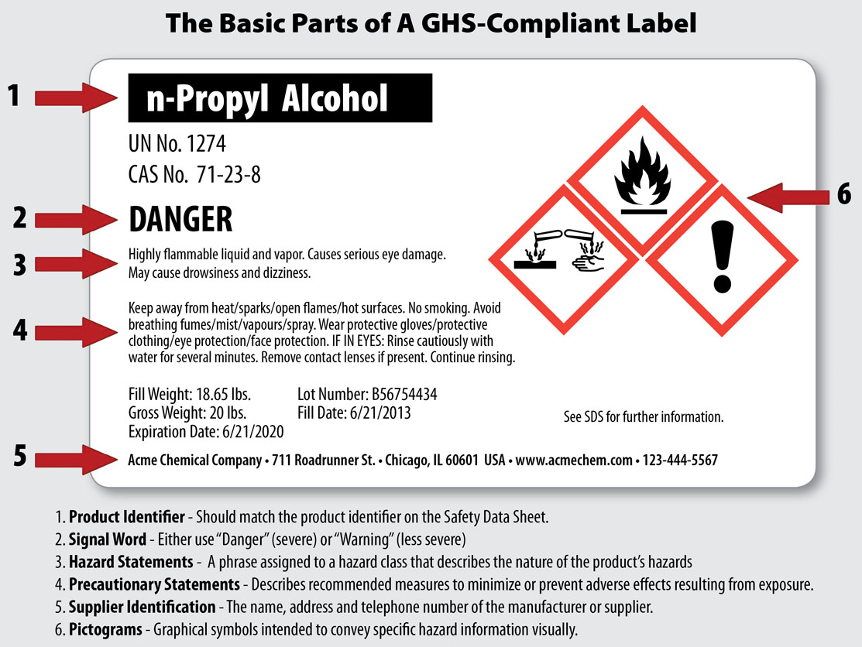
Requirements of a GHS Label

Slide 11
Pictograms
A symbol plus a red diamond border intended to convey specific information about the hazards of a chemical.
4 Health Hazard Pictograms
5 Physical Hazard Pictograms

Slide 12
Health Hazard Pictogram- Corrosion
Skin Corrosion/Burns
Eye Damage

Slide 13
Health Hazard Pictogram- Exclamation Mark
Irritant (skin and eye)
Skin Sensitizer
Acute Toxicity
Narcotic Effects
Respiratory Tract Irritant
Hazardous to Ozone Layer (non-mandatory)
Notes:
Exclamation mark pictogram is used on a labels for substances which are: Irritant to skin and eye; skin sensitizer which can cause allergic response following skin contact; acute toxicity which may harm the organs and cause organ damage; chemicals that have narcotic effects, respiratory tract irritant when they are inhaled; and chemicals that are Hazardous to the Ozone layer. OSHA does not mandate to use this pictogram for ozone damage, because it does not directly affect the health of workers.

Slide 14
Health Hazard Pictogram- Health Hazard
Carcinogen
Mutagen
Reproductive Toxicity
Respiratory Sensitizer
Target Organ Toxicity
Aspiration Toxicity
Notes:
This pictogram is a symbol of Health Hazard associated with chemicals that can cause health problems over a long period of time. These are carcinogens which can lead to cancer; mutagens which can cause alterations in DNA; reproductive toxicity which affects the ability of men and women to have healthy children; respiratory sensitizers which can cause allergic reactions after exposure; target organ toxicity hazards which can damage or affect the function of a certain organ; and aspiration toxicity hazards which could lead to chemical pneumonia, and varying degrees of pulmonary problems.

Slide 15
Health Hazard Pictogram- Skull & Crossbones
Acute Toxicity (fatal or toxic)
Notes:
The skull and cross bones pictogram is used to identify the chemicals which cause acute toxicity hazards. Depending on the toxicity of the chemical, this pictogram indicates that the overexposure of this chemical may be toxic or fatal.

Slide 16
Physical Hazard Pictogram- Flame
Flammables
Pyrophorics
Self-Heating
Emits Flammable Gas
Self-Reactives
Organic Peroxides
Notes:
This pictogram is a symbol of a flame. It is associated with flammable liquids, solids and aerosols. Also indicated by this pictogram are pyrophorics which are capable of igniting spontaneously in air; self heating chemicals which generate heat by reaction with air without any energy supply. It will also appear on chemical products that emits flammable gases, self reactive products** (Type B, C, D, E, F) which are thermally unstable liquid or solid substances or mixtures liable to undergo a strongly exothermic decomposition even without participation of oxygen; and organic peroxides*** (types B, C, D, E, F) which are found in many products such as accelerators, activators, cross-linking agents and curing agents.
**Self reactive types;
Type B- as packaged, does not detonate or deflagrate rapidly but is capable of undergoing a thermal explosion. (Heating causes fire)
Type C – as packaged, possesses explosive properties but will not detonate, deflagrate or thermally explode;
Types D, E, F – have shown hazards such as partial detonation, etc. when tested in a laboratory but do not possess these hazards as packaged.
***Organic peroxide types:
Type B- Any organic peroxide possessing explosive properties and which, as packaged, neither detonates nor deflagrates rapidly, but is liable to undergo a thermal explosion in that package
Type C- Any organic peroxide possessing explosive properties when the chemical as packaged cannot detonate or deflagrate rapidly or undergo a thermal explosion
Type D-
(i)Detonates partially, does not deflagrate rapidly and shows no violent effect when heated under confinement; or
(ii) Does not detonate at all, deflagrates slowly and shows no violent effect when heated under confinement; or
(iii) Does not detonate or deflagrate at all and shows a medium effect when heated under confinement;
Type E-Any organic peroxide which, in laboratory testing, neither detonates nor deflagrates at all and shows low or no effect when heated under confinement
Type F- Any organic peroxide which, in laboratory testing, neither detonates in the cavitated state nor deflagrates at all and shows only a low or no effect when heated under confinement as well as low or no explosive power

Slide 17
Physical Hazard Pictogram- Flame Over Circle
Oxidizer –
a substance that is not necessarily combustible, but may, generally by yielding oxygen, cause or contribute to the combustion of other material
Notes:
This pictogram of a flame over circle associated with materials that are classified as oxidizers. Oxidizers are substances that release oxygen to the another material for the purpose of combustion. They help the materials burn much more rapidly than they normally would. Therefore, they should not be stored close to flammable materials.

Slide 18
Physical Hazard Pictogram- Gas Cylinder
Gases under pressure
Notes:
The gas cylinder pictogram will appear on labels of cylinder of compressed gases under pressure. This pictogram on a chemical label means that the substance is a compressed, liquefied, or dissolved gas at 29 pounds per square inches or more.

Slide 19
Physical Hazard Pictogram- Exploding Bomb
Explosives
Self-Reactives
Organic Peroxides
Notes:
The exploding bomb pictogram is used for explosives which are capable (by chemical reaction) of producing gas at such a temperature and pressure, and at such a speed as to cause damage to the surroundings; self reactives (types A, B)** which are tthermally unstable liquid or solid substances or mixtures liable to undergo a strongly exothermic decomposition even without the participation of oxygen; and organic peroxides (types A, B)*** which are found in many products such as accelerators, activators, cross-linking agents and curing agents.
**Self reactive substance types:
Type A – as packaged, will detonate or deflagrate rapidly;
Type B – as packaged, does not detonate or deflagrate rapidly but is capable of undergoing a thermal explosion. (Heating causes explosion)
***Organic peroxide types:
Type A -Any organic peroxide which, as packaged, can detonate or deflagrate rapidly
Type B - Any organic peroxide possessing explosive properties and which, as packaged, neither detonates nor deflagrates rapidly, but is liable to undergo a thermal explosion in that package

Slide 20
Physical Hazard Pictogram- Corrosion
Corrosive to Metals
Notes:
The corrosion pictogram appears on containers of chemicals which cause skin corrosion or burns, and eye damage. It is also used for materials which are corrosive to metals.

Slide 21
Non-mandatory Pictogram- Environment
Aquatic Toxicity
Notes:
The last pictogram, which is environment, appears on chemicals that are considered as toxic to plants and aquatic life. OSHA does not enforce the use this pictogram because it does not directly affect the health of exposed workers.

Slide 22
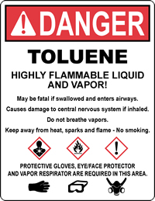
Signal Words
“Danger” – more severe hazards
“Warning” – less severe hazards

Slide 23
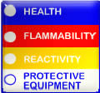
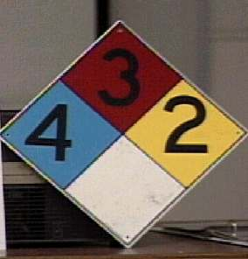
HMIS/NFPA Labeling Systems
Blue - Health
Red – Flammability
Yellow – Reactivity
White – Protective Equipment and Other
Scale 0-4
0 = no danger
4 = highest danger

Slide 24
Safety Data Sheets (SDS)
SDS are multi-page documents that contain more detailed information about a chemical than the container label.
The revised HazCom standard requires that the information on the SDS is presented using consistent headings in a specific order.

Slide 25
Safety Data Sheets
Detailed information sheet prepared by manufacturer or importer
Available for every hazardous chemical or substance
Contains information that:
Enables you to prepare for safe day-to-day use
Enables you to respond in emergencies

Slide 26
16-Section SDS Format
Identification
Hazard(s) Identification
Composition/Information on Ingredients
First-Aid Measures
Fire-Fighting Measures
Accidental Release Measures
Handling and Storage
Exposure Controls/Personal Protection
Physical and Chemical Properties
Stability and Reactivity
Toxicological Information
Ecological Information
Disposal Considerations
Transport Information
Regulatory Information
Other Information

Slide 27
Location of SDS
Specified work area
Your supervisor will inform you of the specific location
GSU Office of Environmental Safety and Health

Slide 28
Conclusion
Workers have the right to know and understand the hazardous chemicals they use and how to work with them safely.
Always read the chemical label and make sure you understand the information before working with a chemical in the workplace.
For more information, refer to the Safety Data Sheet.

