Slide 1
Grambling State University General Safety Rules
Annual Review
Think Safe, Work Safe, BE SAFE

Slide 2
The department of Safety and Risk Management at Grambling State University primary objectives are to ensure the safety and health of our employees, students, and to protect company property. Our goal is to provide safe and healthful learning and working conditions for all. General Safety is a mandatory safety training that ALL GSU employees must review annually. Purpose: to ensure that everyone is aware of the importance of following safety procedures, informed of their RIGHTS, and how to prevent unfortunate situations. The General Safety Manual Plan is available at: www.gram.edu (gsunet.gram.edu homepage)
Welcome back!

Slide 3
Making Grambling State University a Safe Place to Work and Learn
Safety-related incidents can affect
1. overall productivity
2. quality of work
3. employee morale

Slide 4
GSU non-negotiables
Smoking on GSU property
Fighting and other aggressive behavior
Possession of unauthorized weapons and firearms
alcoholic beverages, illegal drugs, or unauthorized medically prescribed drugs (Inform your immediate supervisor if you are required to take medication during work hours. Written medical evidence stating that the medication will not adversely affect your decision making or physical ability may be required.)

Slide 5
Before beginning work: notify your supervisor of any permanent or temporary impairment that may reduce your ability to perform in a safe manner.
Wear protective equipment
Be properly trained before operating equipment
Inspect the workstation for potential hazards
If there is any doubt about the method of work to be used Consult the supervisor
Return all tools and equipment to a designated place after use
Use proper lifting techniques
Do not throw objects or attempt to catch a falling object
IMMEDIATELY use safety tape or “wet floor” sign to identify potential slip, trip or fall hazards

Slide 6
Driving Safety- COMPLY!
1
2
3
Wear seat belts and do not speed
Remember we have lots of pedestrians that may not be paying attention
Comply with all traffic signs, signals, markers, and persons designated to direct traffic.
University Authorized Drivers
Keep documents updated with the office of Safety and Risk Management
Under no circumstance should you operate a University Vehicle without authorization

Slide 7
Accidents and Incidents Investigation Procedures
For Employees:
When an employee is injured in a non-vehicular accident, the employee’s supervisor must complete the DA 2000- State Employee Incident/Accident Investigation Form.
Forward DA 2000 to The Office of Safety & Risk Management
For Visitors:
When a NON- employee or client is injured in a non-vehicular accident, the University Police must complete the DA-3000- Visitor/Client Accident Reporting.
Forward DA 3000 to the Office of Safety & Risk Management
Definition of Terms:
An accident is “an undesired event that results in personal injury and/or property damage.” Involving Employees, Clients/visitors and/or Property
An incidents (Near Misses) which could have caused injury and/or property damage involving Employees, Clients/visitors and/or Property
Every effort should be made to prevent an accident from happening in the first place.
“Near misses” are accidents also and should be investigated as thoroughly as an accident that results in injury or property damage.

Slide 8
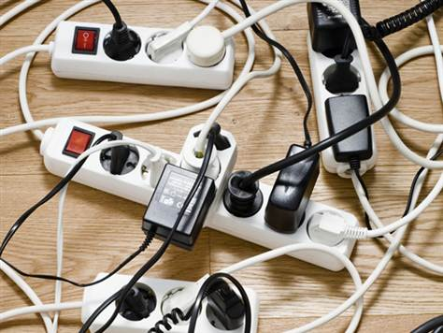
Common ELECTRICAL issues to avoid
Report frayed electrical cords immediately
Do not use electrical extension cords as a permanent electrical line.
Never turn on an electrical switch unless you know what it operates and have had the adequate training on that piece of equipment
Keep flammable items away from electrical outlets, cords or other electrical apparatus.

Slide 9
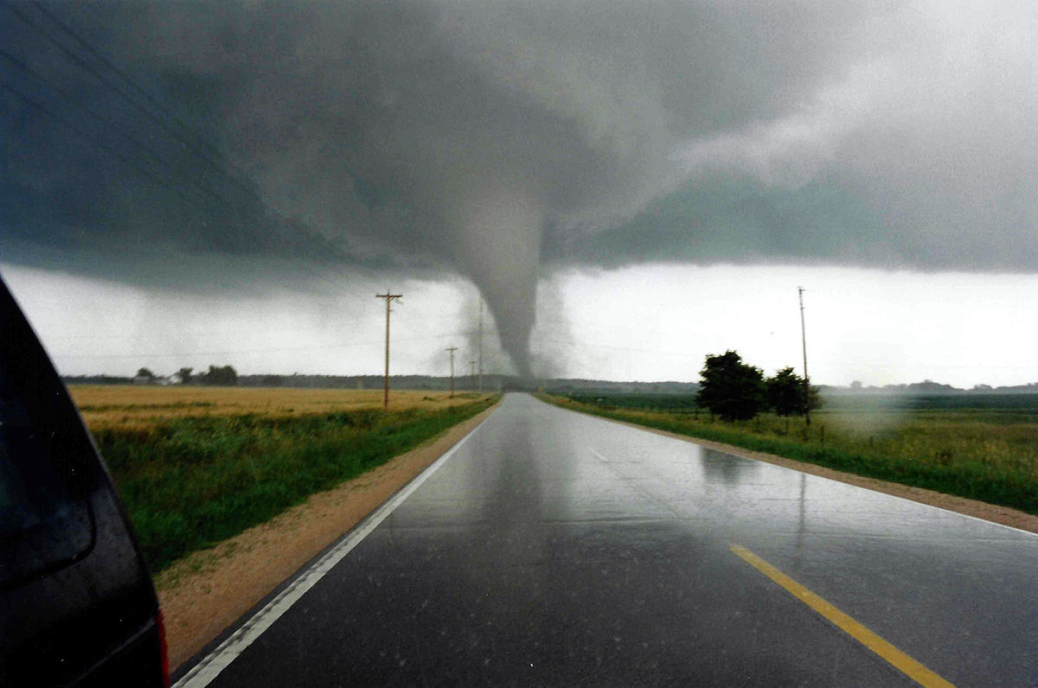
WEATHER EMERGENCY
Review weather emergency procedures
Located in General Safety Manual (Plan)
Know the safety zone
Follow safety and evacuation protocol
Think Responsibly and move quickly to the safety zone

Slide 10
Preventing workplace incidents is everyone’s job, and your personal safety is FIRST your responsibility.
Employees who do not comply with university safety rules may be subject to disciplinary action.

