Slide 1


Safety Spotlight
Electrical Safety
Notes:
Thank you for including me…
My background – over 25 years of commercial Property and Casualty insurance experience, specializing in marketing, product development, and the utilization of client-facing technologies.
Began career with Willis, then was with Sedgwick which became Marsh, then spent the last 15 years with WGA and came into Gallagher as a merger partner in 2015.
Beyond all my marketing years, I was a producer while at Marsh and when I started at WGA, making me uniquely qualified to know what it takes for all of you to get the kind of opportunities I want to work on with you.

Slide 2
Fundamentals of Electrical Hazards
To flow, electricity must have a complete path.
Electricity flows through conductors.
  water, metal, the human body
Insulators are non-conductors.
The human body is a conductor.

Slide 3
Fundamentals of Electrical Hazards
Have You Ever Been Shocked?
THE BASICS

Slide 4

What are the levels of effect of current?
AC current (mA) | Effect on human body
1 | Slight tingling sensation
2-9 | Small shock
10-24 | Muscles contract causing you to freeze
25-74 | Respiratory muscles can become paralysed; pain; exit burns often visible
75-300 | Usually fatal; ventricular fibrillation; entry & exit wounds visible
>300 | Death almost certain; if survive, will have badly burnt organs and probably require amputations

Slide 5
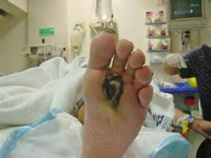
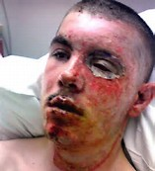
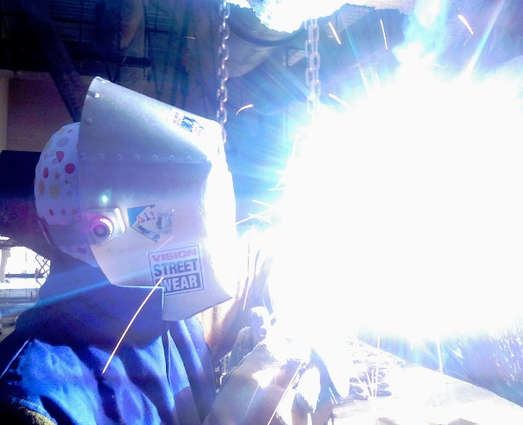

What are the types of injuries?
Burns
Shocks
Arc
Fire
Explosion

Slide 6
Fundamentals of Electrical Hazards
Hazards of Electricity
  Electrocution/Shock/Burns/Death
                Minimum distance from overhead lines 10 ft.
  Electrical tools and equipment
  Inspect for: frayed, cut, broken wires; grounding
  prong missing; improper use of cube taps; improperly
  applied or missing strain relief

Slide 7
Qualified vs. Unqualified Personnel
For purposes of electrical safety, there
are 2 types of workers: Qualified and Unqualified
  A qualified worker:
    Is trained to avoid electrical hazards when working on
    or near exposed energized parts
    Is familiar with OSHA standards and work practices
    Can distinguish exposed live parts of electrical equipment
    Knowledgeable of the skills and techniques used to
    determine nominal voltages of exposed parts/components

Slide 8
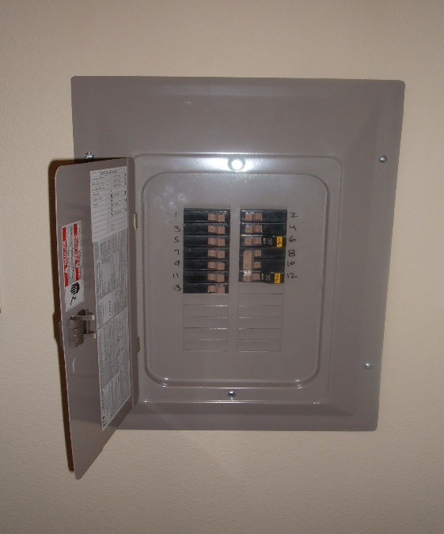
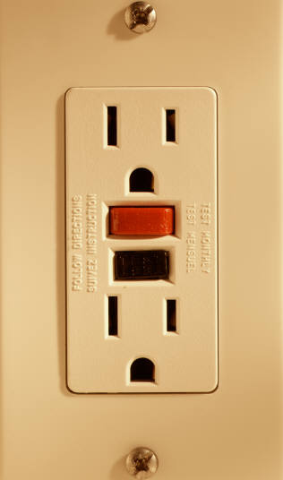
Electrical Protection
Circuit Breakers
  Provided to protect EQUIPMENT not people
  Do not reset breakers with a line voltage higher than 120V and only reset if you know why it tripped
  GFCI’s
    Provided to protect people
    Trip range 4-6ma
    Monthly test

Slide 9
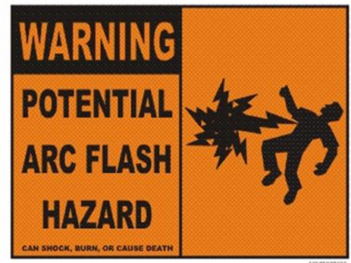
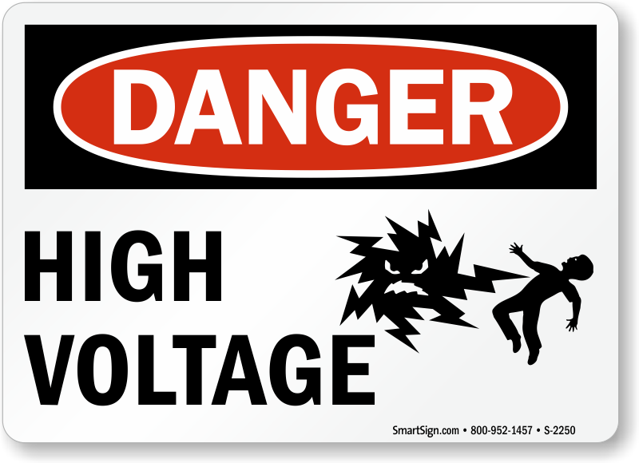
Electrical Protection
Distance
  If you sense the presence of an electrical hazard or exposed conductors that may be energized, keep your distance and STAY AWAY.

Slide 10
How Electricity Works
Example: A Garden Hose
Flow of Water
To Low Pressure
Water Moves from High Pressure
The same thing occurs in an Electrical Wire
Flow of Current
Current Moves from High Voltage
To Low Voltage
Notes:
To understand how electricity can affect our bodies we must first understand how electricity does its work.
As the diagram shows above, electricity (like water) uses its current flow to perform its work and as it does so its voltage drops from high to low.

Slide 11
Fundamentals of Electrical Hazards
Voltage
  electrical pressure
Amperage
  electrical flow rate
Impedance
  restriction to electrical flow

Slide 12
Fundamentals of Electrical Hazards
Circuit
  path of flow of electricity
Circuit Element
  objects which are part of a circuit and
  through which current flows
Fault
  current flow through an unintended path

Slide 13
Fundamentals of Electrical Hazards
What is Grounding?
  Protection from electric shock
    normally a secondary protection measure
A ground is a conductive connection
  between electrical circuit or equipment and earth or ground plane
  creates a low resistance to the earth

Slide 14

Ground-Fault Protection
The ground-fault circuit interrupter (GFCI) works by comparing the amount of current going to and returning from equipment along the circuit conductors. When the amount going differs from the amount returning by approximately 5 milliamperes, the GFCI interrupts the current within as little as 1/40 of a second.
Note: A GFCI will not protect you from line contact hazards (i.e.
a person holding two "hot" wires, a hot and a neutral wire in each hand, or contacting an overhead power line). However, it protects against the most common form of electrical shock hazard, the ground-fault. It also protects against fires, overheating, and destruction of wire insulation.
Notes:
Who recognizes this device. Who can tell me where you might a Ground Fault Circuit Interrupter in your home?
Why is it installed there?
(Wet location – conductivity of water)‏
How does it work?
(Measures difference in current between hot and neutral – anything over 5mA will trip GFCI)‏
How do you test it?

Slide 15
Basic Rules of Electrical Action
Electricity isn’t live until current flows.
Electrical current won’t flow until there
is a complete loop, out from and back to
the power source.

Slide 16
Grounding - How Do I Avoid Hazards
Ground all power supply systems, electrical circuits, and electrical equipment.
Do not remove ground pins/prongs from cord- and plug-connected equipment or extension cords.
Use double-insulated tools.
Ground all exposed metal parts of equipment.
Notes:
In the next few slides we are going to discuss how YOU can avoid these electrical hazards. But first…
What is wrong with THESE pictures?
(Top picture - Ground prong missing/removed)‏
(Bottom picture - Dangling electrical bar. 3 to 2 prong adaptors = ground connection missing)‏
How do you avoid grounding hazards – anyone?
You must ground ALL power supplies and electrical equipment
You must NOT remove ground pins
Always use double insulated tools
Make sure that all metal parts on the equipment that YOU or your co-worker are using are grounded
You must examine equipment for damage EVERYTIME BEFORE USE

Slide 17
Do’s and Don'ts
Do plug power equipment into wall receptacles with power switches in the
Off position.
Do unplug electrical equipment by grasping the plug and pulling. Do not pull or jerk the cord to unplug the equipment.
Do not drape power cords over hot pipes, radiators, or sharp objects.

Slide 18
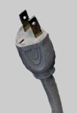
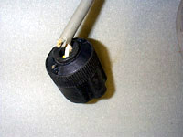
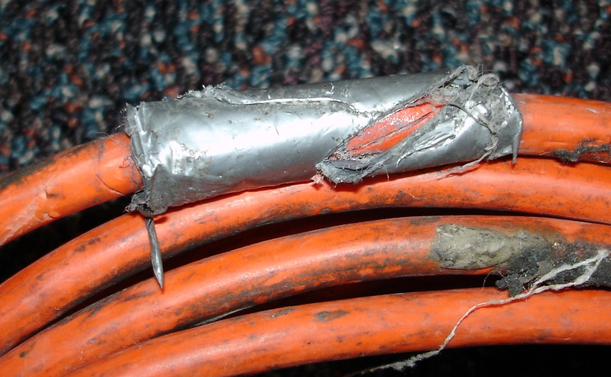
Do’s and Don'ts
Do check the receptacle for missing or damaged parts.
Do not plug equipment into defective receptacles.
Do check for frayed, cracked, or exposed wiring on equipment cords.

Slide 19
Do’s and Don'ts
Do check for defective cords clamps at locations where the power cord enters the equipment or the attachment plug.
Extension cords should not be used in office areas. Generally, extension cords should be limited to use by maintenance personnel.

Slide 20
Do’s and Don'ts
Employees should know the location of electrical circuit breaker panels that control equipment and lighting in their respective areas. Circuits and equipment disconnects must be identified.

