Slide 1

Grambling State University General Safety Rules
(Repeat Training required due to not meeting 100% Employee
Participation during the month of January)
Annual Review
Think Safe, Work Safe, BE SAFE

Slide 2
The Department of Safety and Risk Management at Grambling State University is focused on ensuring the safety and health of our employees, students, as well as protecting our property. We work diligently to support the creation of learning environments that are conducive to learning and working conditions that enhance employee safety.
This “General Safety Rules” training is one of several safety trainings that ALL GSU EMPLOYEES must complete annually. It is designed to help increase our safety awareness, avoid accidents, and to help promote a strong safety culture at GSU.
The General Safety Manual Plan is available at: www.gram.edu
(gsunet.gram.edu homepage)

Slide 3

Making
Grambling State University a Safe Place to Work and Learn
Safety-related incidents impact:
Employee productivity and ultimately our efforts to support our students
Our quality of work
Employee morale

Slide 4

GSU
Non-Negotiable Safety Items
Smoking on GSU property.
Fighting and other aggressive behavior.
Possession of unauthorized weapons and firearms.
Use of alcoholic beverages, illegal drugs, or unauthorized medically prescribed drugs. Inform your immediate supervisor if you are required to take medication during work hours.
* Medical documentation stating that the medication will not adversely affect your decision making or physical ability may be required.

Slide 5
Before beginning work, please notify your supervisor of any permanent or temporary impairment that may reduce your ability to perform in a safe manner.
Wear protective equipment
Be properly trained before operating equipment
Inspect the workstation for potential hazards
If there is any doubt about the method of work to be used be sure to consult your supervisor
Return all tools and equipment to a designated place after use
Use proper lifting techniques
Do not throw objects or attempt to catch a falling object
IMMEDIATELY use safety tape or “wet floor” sign to identify potential slip, trip or fall hazards

Slide 6
Demonstrating safe driving strengthens our safety culture!
1
2
3
Wear seat belts and do not speed. Remember we have lots of pedestrians that may not be paying attention.
Comply with all traffic signs, signals, markers, and persons designated to direct traffic.
University Authorized Drivers…
Keep documents updated with the Office of Safety and Risk Management.
Under no circumstances should you operate a University vehicle without authorization.

Slide 7
Accidents and Incidents
Investigation Procedures
For Employees:
When an employee is injured in a non-vehicular accident, the employee’s supervisor must complete the DA 2000- State Employee Incident/Accident Investigation Form.
Once completed, forward DA 2000 to The Office of Safety & Risk Management.
For Visitors:
When a non-employee or client is injured in a non-vehicular accident, the University Police must complete the DA-3000- Visitor/Client Accident Reporting.
Once completed, please forward DA 3000 to the Office of Safety & Risk Management.
Definition of Terms:
An accident is “an undesired event that results in personal injury and/or property damage” involving employees, clients, visitors, and/or property.
An incident (near miss) is an event that could have caused injury and/or property damage involving employees, clients/visitors and/or property.
Every effort should be made to prevent an accident from happening in the first place.
“Near misses” are accidents also and should be investigated as thoroughly as an accident that results in injury or property damage.

Slide 8
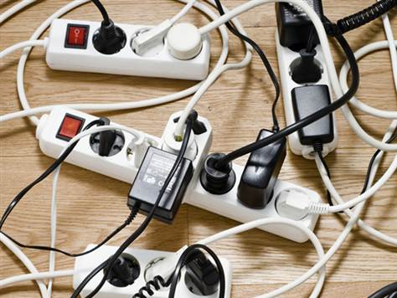
Common ELECTRICAL Issues to Avoid
Please report frayed electrical cords to your supervisor immediately.
Do not use electrical extension cords as a permanent electrical line.
Never turn on an electrical switch unless you know what it operates and have had the adequate training on that piece of equipment.
Keep flammable items away from electrical outlets, cords or other electrical appliances/tools.

Slide 9
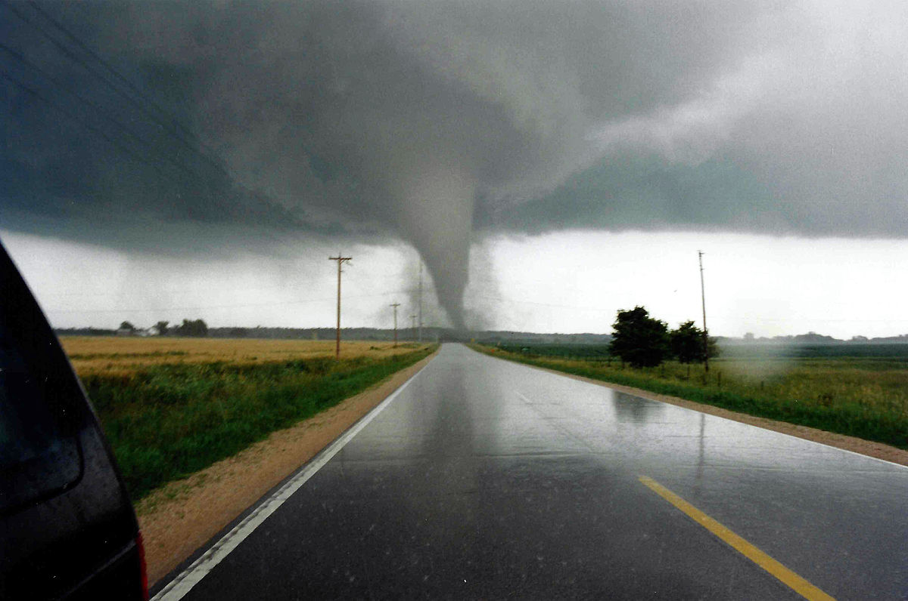
WEATHER EMERGENCY
Review weather emergency procedures in the General Safety Manual.
Know the location of your safe areas where you can take shelter.
Follow safety and evacuation protocols if an evacuation is ordered.
Think responsibly and be situationally aware.

Slide 10

Focusing on the safety and health of our employees and students helps us create learning environments that strengthen learning and create working conditions that enhance employee safety.
Employees who do not comply with GSU safety rules may be subject to disciplinary action.
If you have any questions or concerns, please feel free to reach out to the Department of Safety and Risk Management at extension 2174 or 2419. Have a great and SAFE day!

