Slide 1
BLOOD BORNE PATHOGEN
SAFETY MEETING September 2021

Slide 2
PURPOSE
Blood Borne Pathogen training is a Required training for all employees. The purpose of the training is to provide awareness and best work practice controls to keep our staff, Faculty, and students safe.
Let’s Be REAT!

Slide 3
What are BloodBorne Pathogens
Bloodborne pathogens are infectious microorganisms in human blood that can cause disease in humans.
These pathogens include, but are not limited to
hepatitis B (HBV)
hepatitis C (HCV)
human immunodeficiency virus (HIV).
Needle sticks and other sharps-related injuries may expose workers to bloodborne pathogens.

Slide 4
EXPOSURE CONTROL
OSHA BLOODBORNE PATHOGEN STANDARDS
Each employer having an employee(s) with occupational exposure shall establish a written Exposure Control Plan designed to eliminate or minimize employee exposure.
Methods of Compliance
Employee Training
Evaluation and Follow-up
Communication of Hazards to Employees
Recordkeeping
See the GSU safety and Risk Management webpage under OSHA Bloodborne Pathogens Standard for complete details.

Slide 5
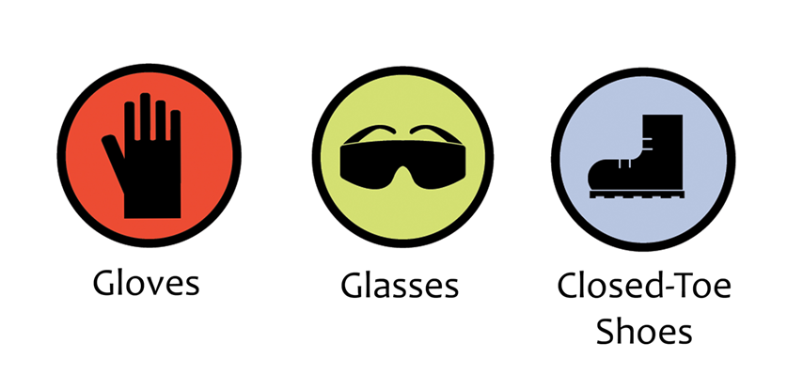
WORK PRACTICE CONTROLS
Use personal protective equipment (PPE)
Gloves
Eyewear
Proper shoes and clothing
Specific job PPE
Wash Hands regularly
Decontaminate and sterilize equipment and areas
Safely handle sharps
Correctly dispose of wastes
Safely handle laundry
RESTICT Work area to designated employees

Slide 6
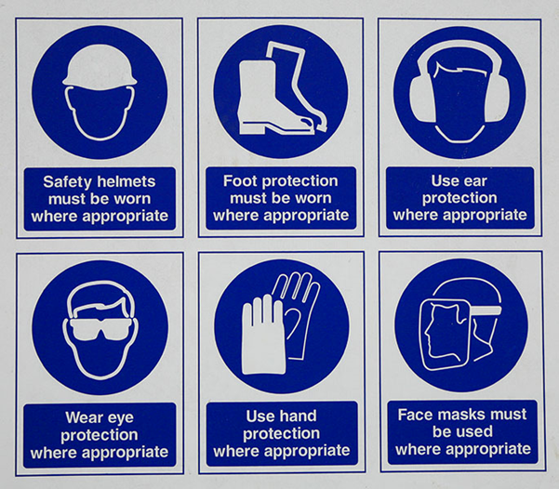
EXAMPLES OF PERSONAL PROTECTIVE EQUIPMENT (PPE)

Slide 7
GSU Blood Borne Pathogen Exposure Response
The following actions should be taken immediately after exposure:
Administer first aid. Wash the needlestick or cut with soap and water. Notify your supervisor as soon as feasible.
If exposure is by splashes or infectious materials to the nose, mouth or eyes, flushed the affected area extensively with water, saline or sterile irrigating solution.
Document the routes of exposure, the biological material of exposure, and how the incident occurred.
Seek medical attention as soon as possible. HIV prophylaxis is most effective if started within two hours of exposure.
After initial treatment is complete, make an appointment with your healthcare provider as soon as possible for appropriate follow-up.

Slide 8
For PPE please complete a work order
Go to GSU Home page: gram.edu
At the upper right corner click on: “Select a Site”
Scroll down to select Facilities then click “Go”
Scroll down to resources and select “Submit a work order request”
This link will lead you to the TMA system
In TMA systems select “Submit a Work Order” on the top left corner of the page
Complete the form with required criteria listed below:
Facility
Building
Floor or Area
Name
Number
Email Address
Repair Center
Request

Slide 9
Contact Information
If you have any questions
Please contact safety and risk management
Director of Safety and Risk Management
PORCHA JANUARY WILLIAMS
williamspo@gram.edu
318.274.2419
Safety and Risk Manager
EDWARD MARISH
marishe@gram.edu
318.274.3174

