Slide 1

Travel
Procedures

Slide 2
Content
Travel Team
Docusign Form
Travel Process
Encumbrance
Estimated Expenses
Hotel
Airfare
Rental/ Personal vehicle
Registration fee
Group Meals
Travel with Students
CBA holders
FAQ's
Travel
Office

Slide 3
Meet our travel team
travel@gram.edu
Annes Newton
Travel Specialist
Travel Office
Office Phone: 318-274-2576
Email: newtona@gram.edu
Carline Valmond
Assistant to the Controller
Controller's Office
Office Phone: 318-274-6091
Email: valmondl@gram.edu

Slide 4
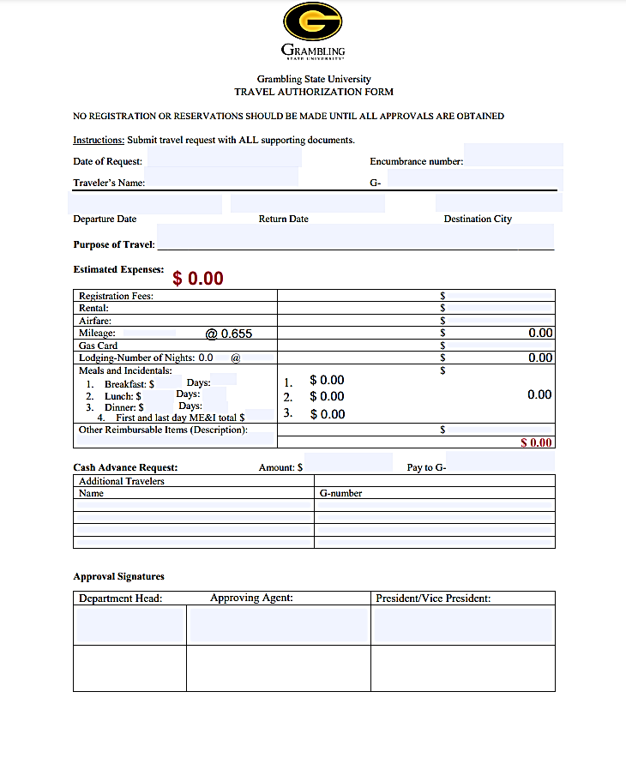

Good-bye CONCUR
Hello Docusign!
Docusigns
Under Finance >
Under Travel Office
Notes:
We will quickly browse over Concur due to state changes that will be implemented in July

Slide 5

Summary of Travel Process
Ensure that you are an Authorized Driver (if not, contact mcmahonj@gmail.com)
Encumber Travel Funds
Submit Travel Request via Docusign with all supporting information 10 days prior to travel
Ensure all travel items are paid for-3 days prior to travel
Submit Expense Report
Get Reimbursed
PPM49
Notes:
Before starting, please note that Encumbrance training can be done with IT
If you do not have access to encumber the funds, then contact the custodian of the account that you are using.

Slide 6
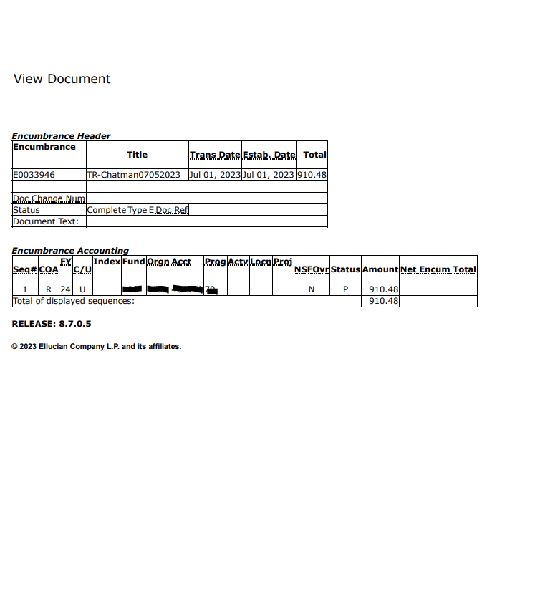
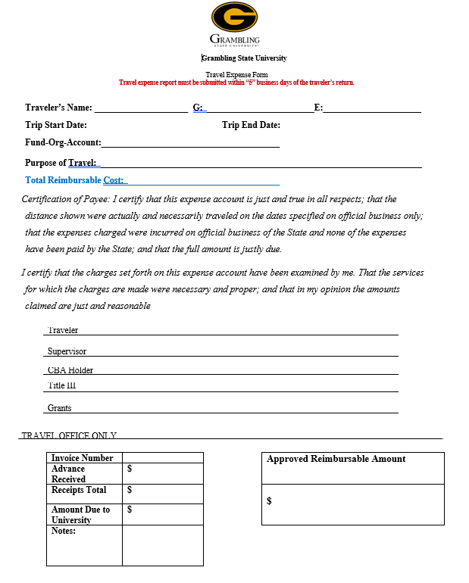
Summary Continued:
Encumber Funds
Expense Excel and Expense Docusign
Travel Request Docusign

Slide 7
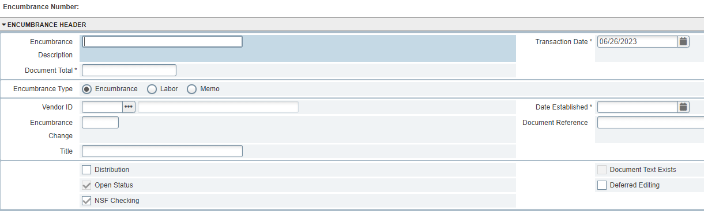
How to do an Encumbrance
Go into banner9
Type in FGAENCB
Encumbrance- enter last name, first initial, date of trip e.g Valmond, C 10/1/23
Document total-insert the amount needed
Select encumbrance
Click on Related in the top right corner
Click GO
Next page

Slide 8
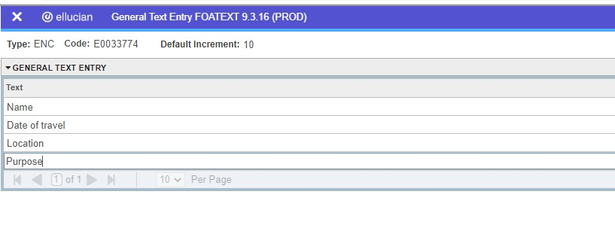
Continued...
Click Complete to submit Encumbrance request
Click on Document text
Enter name of traveler and related information as follows
Save then X out of tab, press down arrow at bottom of page
Journal type E010
Insert necessary information
For step-by-step instructions, contact the travel office.

Slide 9
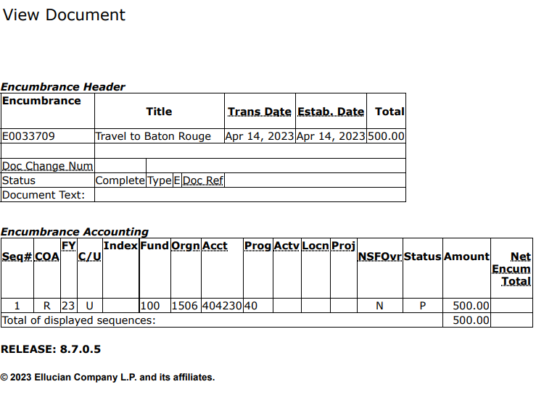
COMPLETED ENCUMBRANCE
Attach to Docusign
Encumbrance total
Encumbrance approval history
Notes:
Before starting, please note that Encumbrance training can be done with IT
If you do not have access to encumber the funds, then contact the custodian of the account that you are using.
The encumbrance document should look like this

Slide 10
AIRFARE
Christopherson Business Travel (CBT)
*** Once the Travel Office has approved your travel request, you will receive an email stating you may proceed with booking your flight.
To book a flight you must first create a profile (24hrs before use): create profile
Log into Airportal Log in
Go to Book Travel. Book/Manage Online Trips
For the method of payment please select the CBA card that is already on file ending
In *1111.
Attach the list of flight options to your travel request.
Notes:
Once you have created a profile, you will receive a welcome email within 24 hours!
When creating profile, you either select grambling state university or grambling state university athletics

Slide 11
Airfare continued…
TO BOOK FOR AN EMPLOYEE
Go to Profile
Under Acting as other user enter the user’s name that you are performing duties for
or select the name from the drop-down list.
Then select Start Session
TO BOOK FOR A STUDENT
Book for guest should be to the right of Trip Search, if it is not, then you will have to contact Christopherson at trips@cbtravel.com/800-600-3737
Business Travel to add it to your profile
Once you select book for guest, then insert the student’s information and proceed with booking the flight
If you are unsure that you have completed purchase-verify with travel office

Slide 12
Hotel
  Attach the hotel credit card authorization form
          OR
  Have Hotel email credit card authorization link to travel email with name and confirmation number
  For in-state hotels, you must provide the hotel with the hotel state tax exemption form: Tax Exemption Form
  Verify that Hotel has corporate number 2 days prior (Esp Marriot)
Notes:
If the hotel is to be paid by the travel office, then attach the hotel credit card authorization form

Slide 13
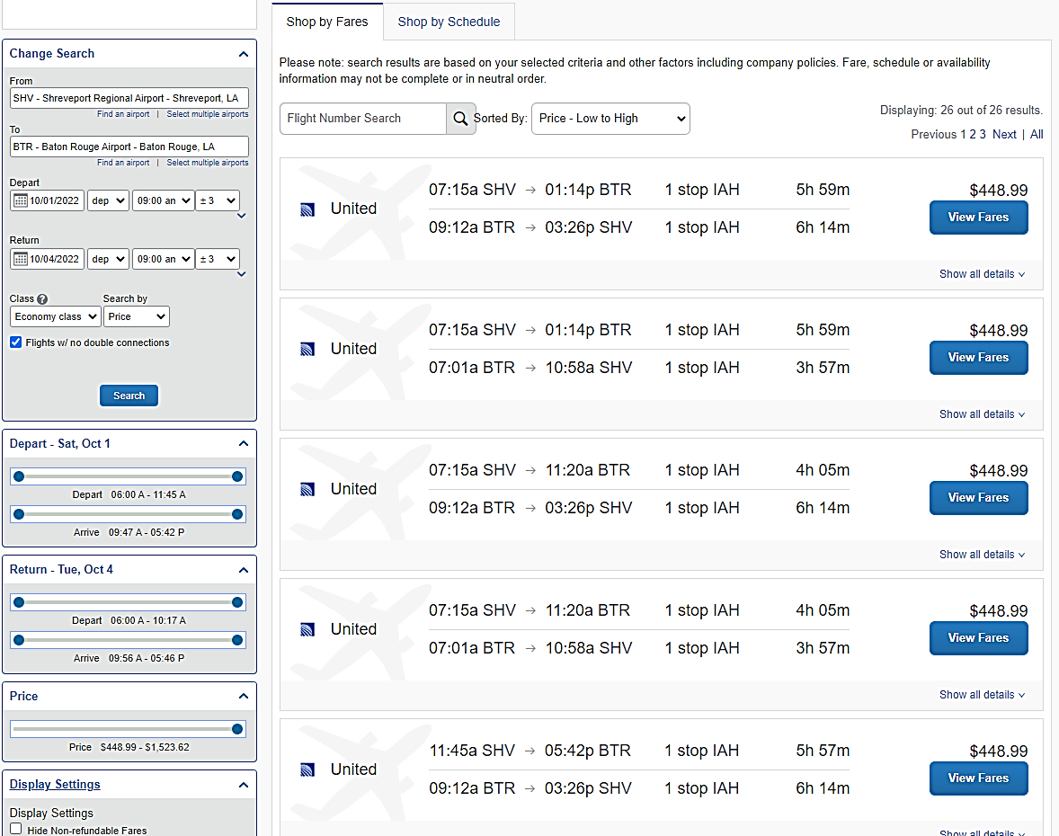
The airfare quotes should look like this.
Select Shop by Fares to show the amount.

Slide 14
Meals
This expense consists of 4 options
Breakfast
Lunch
Dinner
Group Meals (cash advance for non-card holder)
If paid out of pocket for students or received a cash advance for meals, then list of students and g-numbers is required.
Refer to Per diem to determine the meal allowance (search by state and fiscal year).
  In travel Request form, insert number of days excluding first and last day.
  There is a separate box for First and Last day ME&I total (i.e 2 x 51.75= 103.5), put in $103.50
  If traveling with a group of students, do not enter meals, enter cash advance total only

Slide 15
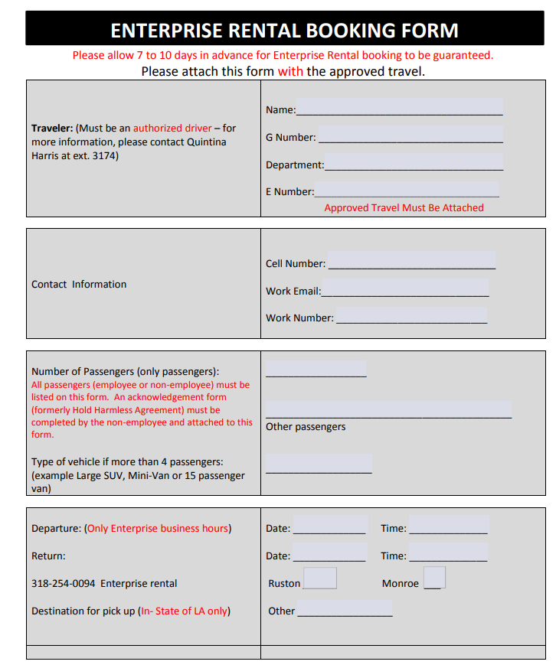
CAR RENTAL
Attach car rental booking form to the travel request: Enterprise form
A justification letter with supervisor's approval is required for larger vehicles
Car rentals will be reserved and paid by CBA holders.
Out of State Travels will get reimbursed for gas. (receipts are required).
For in state car rental, once your travel request is approved, the Travel Office will email you to collect your gas card from Becky Fields (ext. 4460- located at property and receiving) (carry a copy with you).
Notes:
If you are requesting a larger size vehicle and there are less than 4 passengers, then a justification letter is required.

Slide 16
CAR RENTAL Cont...
If traveling with non-GSU employees, the travel office MUST be notified, and a liability form MUST be submitted
Personal vehicles are allowed with proof that no rental vehicles were available and prior authorization from supervisor is given. Otherwise, traveler will only be reimbursed for a maximum of 99 miles.
Notes:
If you are requesting a larger size vehicle and there are less than 4 passengers, then a justification letter is required.

Slide 17
Mileage expense TYPE
  * Distance traveled to airport is reimbursable- attach map-quest to show distance traveled
  *State-owned vehicle or state rented vehicle should be used prior to a personal vehicle when mileage exceeds 99 miles
  *If a rental car is not available, proof of unavailability and prior authorization from one's supervisor is required in order to be reimbursed for more than 99 miles.
  *Justification should be provided if a traveler is requesting to use his/her personal vehicle mileage.
  * Driving directions are required to be attached in ordered to be reimbursed.

Slide 18
Other allowable expenses
This expense consists of 6 options
Baggage
Gas cost to airport (SHV/MLU)
Internet
Parking
Ground Transportation- Uber, Lyft
Tips

Slide 19
Registration/fees
  Attach the website link and your login information
  Please specify which course you are registering for if there are more than one option.
  If a check is needed to pay for the registration fee, then attach the W-9 form.

Slide 20
International Travel Requests
Permission letter to leave the US from President Gallot
Booking out of Christopherson Business Travels/ Airportal requires letter of Approval from the State Office (case by case basis)- Send letter to Travel Office.
Notes:
1. State travel will ONLY communicate with the travel office- No Tom, Dick and Harry

Slide 21
Department CBA Holders
Insert CBA holder information
Melody Ford
Carline Valmond
Academics-
Athletics
George Stubbs
Band- Choir
Student Affairs
Kinesiology-Sheila Griffin
Business-Amanda Sapp
Honors College-Jackie Newsome
Professional Studies-Laketha R.
Enrollment Mgt-Catina Bowman
Kyle Jones
D'Maria Matthews
Erica cosby
Jazmyne Lewis
Administration
Academic Affairs-Erica M.
President's Office
Courtnei Davis
Janice Cowan
Sharon Perkins
Kelsea Smith

Slide 22
Before You Return ☺
Ensure that ALL receipts are to be uploaded including receipt from Hotel

Slide 23
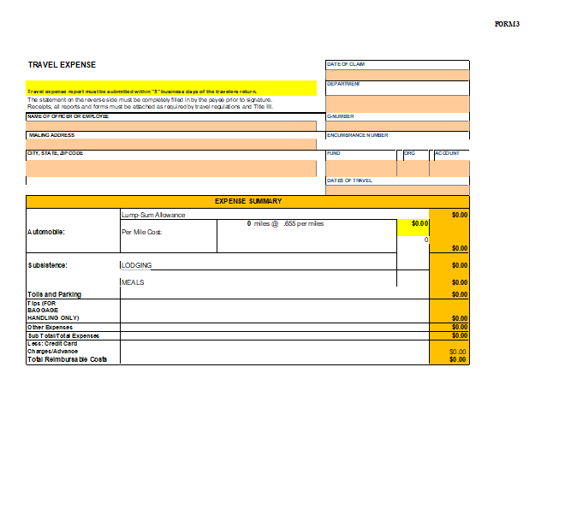
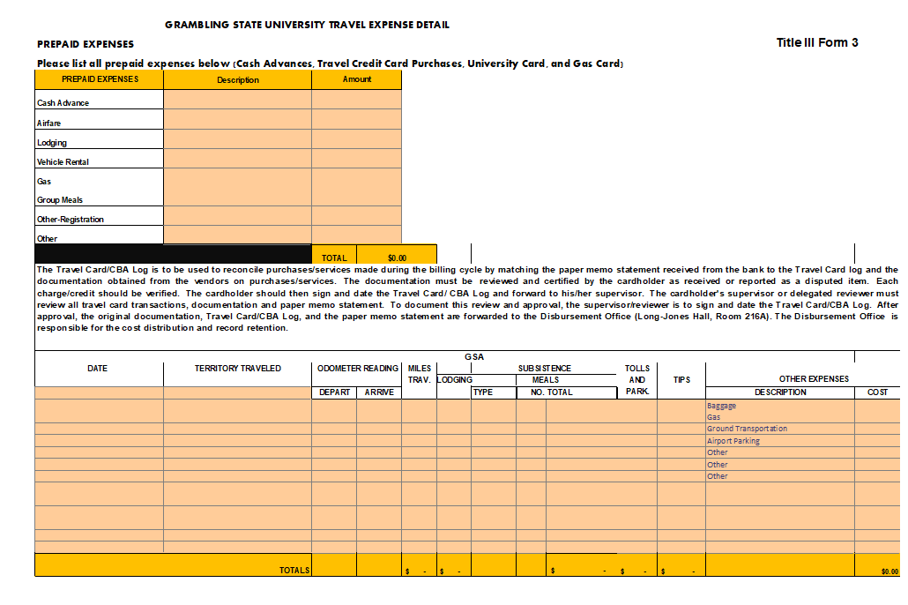
Creating an expense report
  Retrieve Expense Excel document:Travel Office Forms
Page 1
Page 2
2. Fill areas highlighted in peach
3. Values from page 2 will automatically populate into page 1
4.Complete Travel Expense Docusign
5. Attach Approved Travel Request
6. Attach Excel Document
7. Attach ALL receipts
Docusign page

Slide 24
Reimbursements
Ensure that your direct deposit account has been set up: Direct Deposit
Notes:
No checks will be issued

Slide 25
FYI's
One encumbrance and travel request per traveler (students will be placed on the staff's/faculty's travel request)
Every traveler MUST have active Driver Authorization Status to be able to travel on behalf of GSU
Reimbursements for personal meals do not require receipts but must be in accordance with PPM49
Hotels booked above PPM49 rate must at least be at the conference rate, anything higher requires authorization
An Encumbrance adjustment form must be done if traveler went 20% above initial encumbered amount
If traveling under Title III funds, prior approval is needed from Title III for any adjustment

Slide 26
FYi's Expense Excel
You can insert other necessary information/ expense descriptions under Other Expenses
Under meals, you put breakfast, lunch, dinner and First day &/Last day. Next to that you will put the number of days and cost
Do not submit invoice, only receipts
One travel request per staff/faculty
One trip per travel expense

