Slide 1
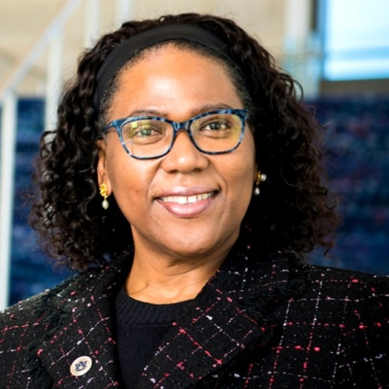
FALL 2021 SEMINAR SERIES
DR. CHERYL SEALS
Virtual Seminar Date: August 26, 2021 ~ 10:00 a.m. CST
https://teams.microsoft.com/l/meetup-join/19%3ameeting_MDkzZjcwZjktZGQ4Yi00YWY2LTg0ZmYtZmM3OWNmMmE4ZDQw%40thread.v2/0?context=%7b%22Tid%22%3a%22def859bf-4db0-4164-b2c1-9da056a4efb8%22%2c%22Oid%22%3a%2200c2ec1c-3a2c-401a-b4a0-f32dccf79d9f%22%7d
Seminar Topic: “A Case for Diversity in Computing: How working with diverse teams foster innovation”

Slide 2
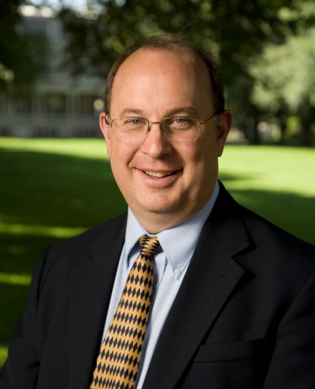
FALL 2021 SEMINAR SERIES
DR. FREDERICK HARRIS
Virtual Seminar Date: September 16, 2021 ~ 9:00 a.m.
https://teams.microsoft.com/l/meetup-join/19%3ameeting_Yjg1YmExM2MtMjljMi00ZDIyLWEyOTItY2IyMmJhYTBmOGUz%40thread.v2/0?context=%7b%22Tid%22%3a%22def859bf-4db0-4164-b2c1-9da056a4efb8%22%2c%22Oid%22%3a%2200c2ec1c-3a2c-401a-b4a0-
Seminar Topic: “Multi-User Virtual Reality Applications”

Slide 3
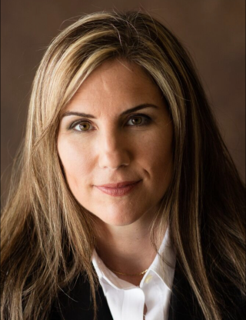
FALL 2021 SEMINAR SERIES
DR. MICHELE MASSBERG
Virtual Seminar Date: September 30, 2021 ~ 10:30 A.M. CST
https://teams.microsoft.com/l/meetup-join/19%3ameeting_NWQ2ZjYzMGEtNGU4Mi00MmM1LWE5MDktMjAzNzliZTg1MDYx%40thread.v2/0?context=%7b%22Tid%22%3a%22def859bf-4db0-4164-b2c1-9da056a4efb8%22%2c%22Oid%22%3a%2200c2ec1c-3a2c-401a-
Seminar Topic: “Counterfeit Detection and Provenance for Cyber Risk Mitigation in Additive Manufacturing Supply Chains”

