Slide 1


GRAMBLING STATE UNIVERSITY
TITLE III PROGRAMS
2022-2023
KICK-OFF WORKSHOP
Thursday, October 6, 2022
8:00 a.m. – 1:00 p.m.

Slide 2

GOALS FOR TODAY’S WORKSHOP
Understand the role and intent of Title III;
To provide technical assistance to Title III Activity Directors
  and Support Staff;
To ensure activities are in compliance with rules and regulations set forth by University, State and Federal guidelines.

Slide 3

INTRODUCTIONS

Slide 4

PURPOSE OF TITLE III
  Title III-B authorizes the Strengthening Historically Black Colleges and Universities (HBCUs) program award grants to eligible institutions to assist them in strengthening their academic, administrative, and fiscal capabilities.
  Academic Quality
    Train and develop faculty; develop curriculum
    Improve developmental or basic skills courses; develop academic program(s),
    Improve class size; acquire specialized accreditation; acquire teaching or research laboratory equipment
    Acquire library materials
  Student services:
    Counseling (peer, career, personal); tutoring and mentoring (peer, staff, faculty),
    Student facilities (general use computer labs, study centers, tutoring centers),
    Create and support learning communities; improve student services (i.e. financial aid distribution process, registration)
    Improve library services

Slide 5
PURPOSE OF TITLE III
  Fiscal Stability
    Establish development office, train development staff, strengthen alumni relations, establish donor database, build capacity to attract external support, build and manage endowment, increase tuition dollars from enrollment, increase research dollars
  Institutional Management
    Create and maintain management information system(s),
    Develop, integrate and update database(s),
    Staff and train an institutional research office,
    Train and develop staff (other than teaching faculty),
    Library facilities (construction, renovation)
    Construction and renovation (classrooms, teaching labs), infrastructure for the internet

Slide 6
INTENT OF TITLE III PROGRAMS
Federal funds made available under this subpart shall be used to strengthen HBCU’s by providing
supplemental funds

Slide 7
THE ROLE OF THE TITLE III OFFICE
Serves a direct report to the University’s President
  The President determines which projects will be supported
Serves as a liaison between the Department of Education and GSU
  Point of contact
  Responsible for individual conduct on the grant
  Issues
    High balances
    System drawdown Errors
    Activity Performance Requests
    Audits

Slide 8

THE ROLE OF THE TITLE III OFFICE AT GSU
Provide SUPPORT
I AM “YOUR” TITLE III DIRECTOR

Slide 9

HBCU, Part B Historically Black Colleges and Universities | $7,410,207
FUTURE, Part F Fostering Undergraduate Talent by Unlocking Resources in Education | $1,352,578
Master’s Programs | $772,289
2022-2023 AWARDS

Slide 10
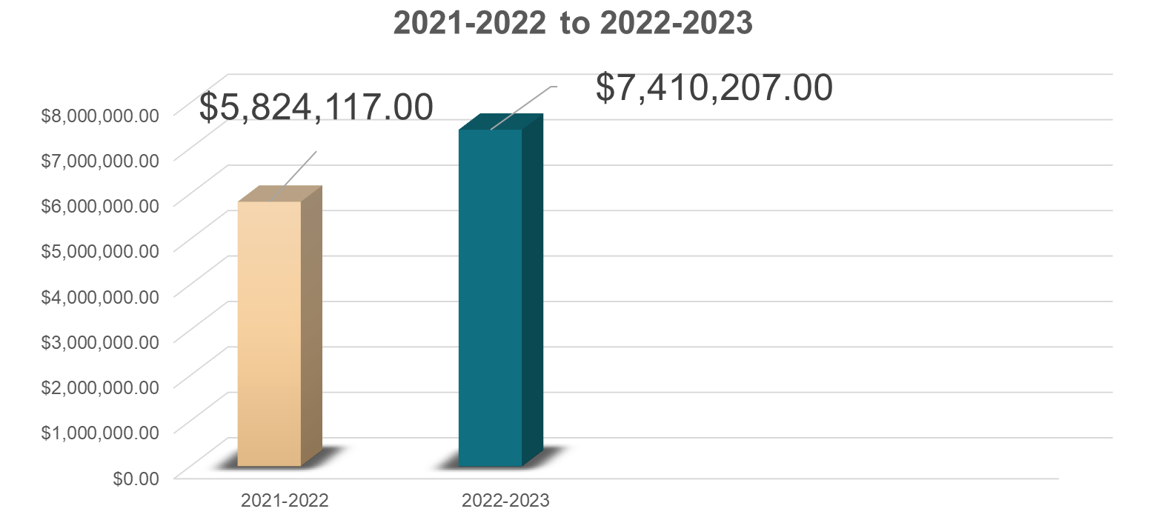

HBCU, PART B
$1,586,090

Slide 11
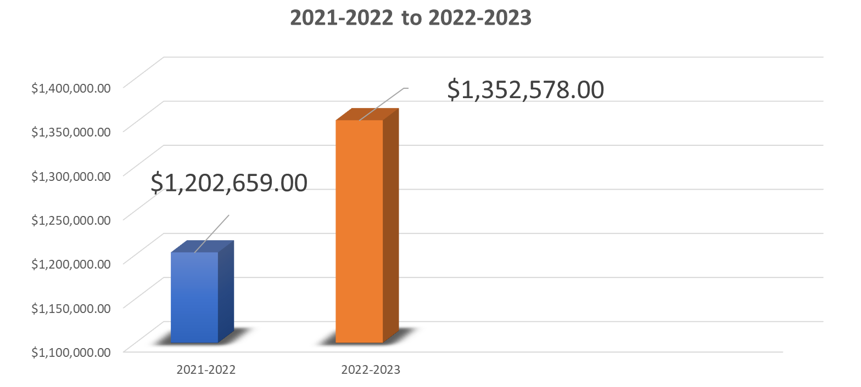
FUTURE, PART F
$149,919

Slide 12
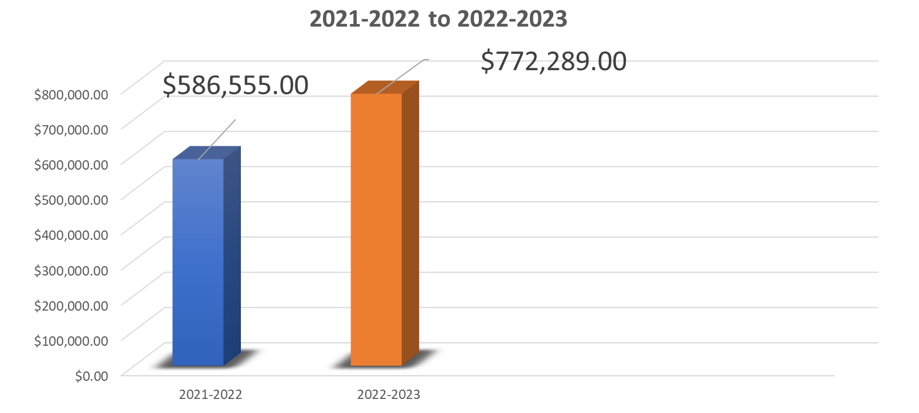
HBCU, MASTERS
$185,734

Slide 13


$6,376,153

Slide 14
PROGRAM REMAINING BALANCES
2015-2022
$242,968,678

Slide 15
the fact of being deliberat
2022-2023
Theme: “Intentionality”
being deliberate;
to be about something;
to represent or to stand for things, properties and states of affairs;

Slide 16
the fact of being deliberat
PRACTICING “INTENTIONALITY”
Reach the 100% expenditure goal
Completion of stated objectives
Plan Ahead
Thorough reporting and collection of documentation
Outcome driven
Leveraging Title III Funds
Additional grant writing
Visiting HBCUs with similar programs
Presenting at conferences
Sustainability

Slide 17
GRANT START UP FORMS
BUDGET CODING FORM – FORM 1
The Budget Coding form is used to set up the yearly budgets of each Title III Activity in the Grants Administration Office. All amounts be the same as the budgeted line items in the APPROVED application.
GRANT FUNDED POSITION- FORM 2
The grant funded position form is to be signed by all Title III employees upon hiring and renewal of contract at the beginning of each grant year. It is to ensure that all Title III employees are aware of the stipulations of Grant Appointment positions and it states: “Your employment with Grambling State University is contingent on the availability of adequate funding. Should funding be cancelled by the funding agency prior to the expiration of an appointment, you will be given as much advance notice as possible. Furthermore, there is no assurance of re-employment after the expiration date of this grant appointment”.
BANNER ACCESS FOR GRANTS- FORM 3
The Banner Finance form provides Activity Directors and support personnel access to requisition entry, budget access and review. The individual identified to enter cannot be the approval.
PERSONEL ROSTER- FORM 4
The personnel roster should include a list of all persons working on the Title III funded grant, whether paid partially or wholly by the grant or paid from the University operating budget. This roster must be updated in the event of a change in personnel.

Slide 18
GRANT START UP FORMS
INFORMATION FORM FOR GRANT DIRECTORS – FORM 5
The form documents the name and contact information of the Activity Directors, administrative support personnel and inventory specialist.
PERSONNEL ACTION FORM (PAF) –The Personnel Action Form must be provided for each individual employed at the university. A new PAF must be completed each year or as there is a change in position. (Docusign)
PREAPPOINTMENT –The pre-appointment form is provided by the Office of Human Resources. This form is used to fill a vacant position. Used to fill an existing Unclassified/faculty position with the same title/money or the money is less than a 10% increase. Used to fill all vacant Classified positions.
BOARD PRIOR APPROVAL –The Personnel Action Form must be provided for each individual employed at the university. A new PAF must be completed each year or as there is a change in position. New position- A position that is not in the budget and requires new monies. Replace/Update – Title change or increase in salary of 10% percent or more Emergency/Temporary- Interim position for up to 12 months. Temporary position for up to 3 months until position can be filled or is no longer needed.

Slide 19
TITLE III FORMS
Budget Adjustment Form – FORM 6 Docusign
Equipment Inventory – FORM 7
Quarterly Progress Report – FORM 9 Docusign
Post Travel Narrative – FORM 8
Certificate of Effort – FORM 10 Docusign

Slide 20
BUDGET INFORMATION
THREE (3) BUDGET ADJUSTMENTS
Last day for Budget Adjustments
June 15th
LAST DAY OF SPENDING
June 30th
(End of 3rd Quarter)
Budget Meetings
Pay Increases/Raises

Slide 21

TITLE III BEST PRACTICES
Plan Ahead
Allow the Title III Office at least 48hrs. to approve requests
Update personnel roster, as needed
Minimize the number of budget adjustments
Check budgets prior to expenditure requests
Track your budget expenditures

Slide 22

TITLE III BEST PRACTICES
Build a rapport with Grants Administration, Purchasing and Accounts Payable
Follow Up and Follow through!
Check estimated times of arrival for equipment
Review inception to date reports – Grants Administration
Maintain good record keeping

Slide 23

Frequently Asked Questions
Can we order office furniture?
Can Title III funds be used to purchase office furniture?
Can Title III funds be used to pay the salaries of administrative assistants?
Can Title III funds be used to pay Activity Directors?
Can Title III funds be used for student wages?
If an Activity is approved for travel, can anyone from the department travel?
Is international travel allowable under Title III?

Slide 24
IMPORTANT DATES
Monthly reports due by the 5th of each month.
2022-2023 Applications located in Title III OneDrive.
Quarterly reports due by the 5th of each quarter.
2020-2021 Annual Performance Report due October 30, 2022.
2020-2021 Annual Performance Report training scheduled for October 18, 2022
Title III National Association of Title III Administrators Conference - June 2023
1st Quarter report due Thursday, January 5, 2023

Slide 25
TITLE III OFFICE
TITLE III DIRECTOR
Tasha Heard
heardt@gram.edu
Ext. 6448
OFFICER MANAGER/PROGRAM ANALYST
Hope Wills
willish@gram.edu
COORDINATOR OF BUDGETS
TBA
COORDINATOR OF PROGRAMS
Fernanda Azouz
azouzf@gram.edu
Ext. 6215
Ext. 6195

Slide 26

IS IMPORTANT.
YOUR FEEDBACK
Please take a few minutes to complete our
EVALUATION FORM.

