Slide 1

Budget Status
History & Overview
2009-2016
Leon Sanders
Vice President of Finance and Administration

Slide 2
FYs 2009-2016 Budget
Operating Fund Revenue

Slide 3
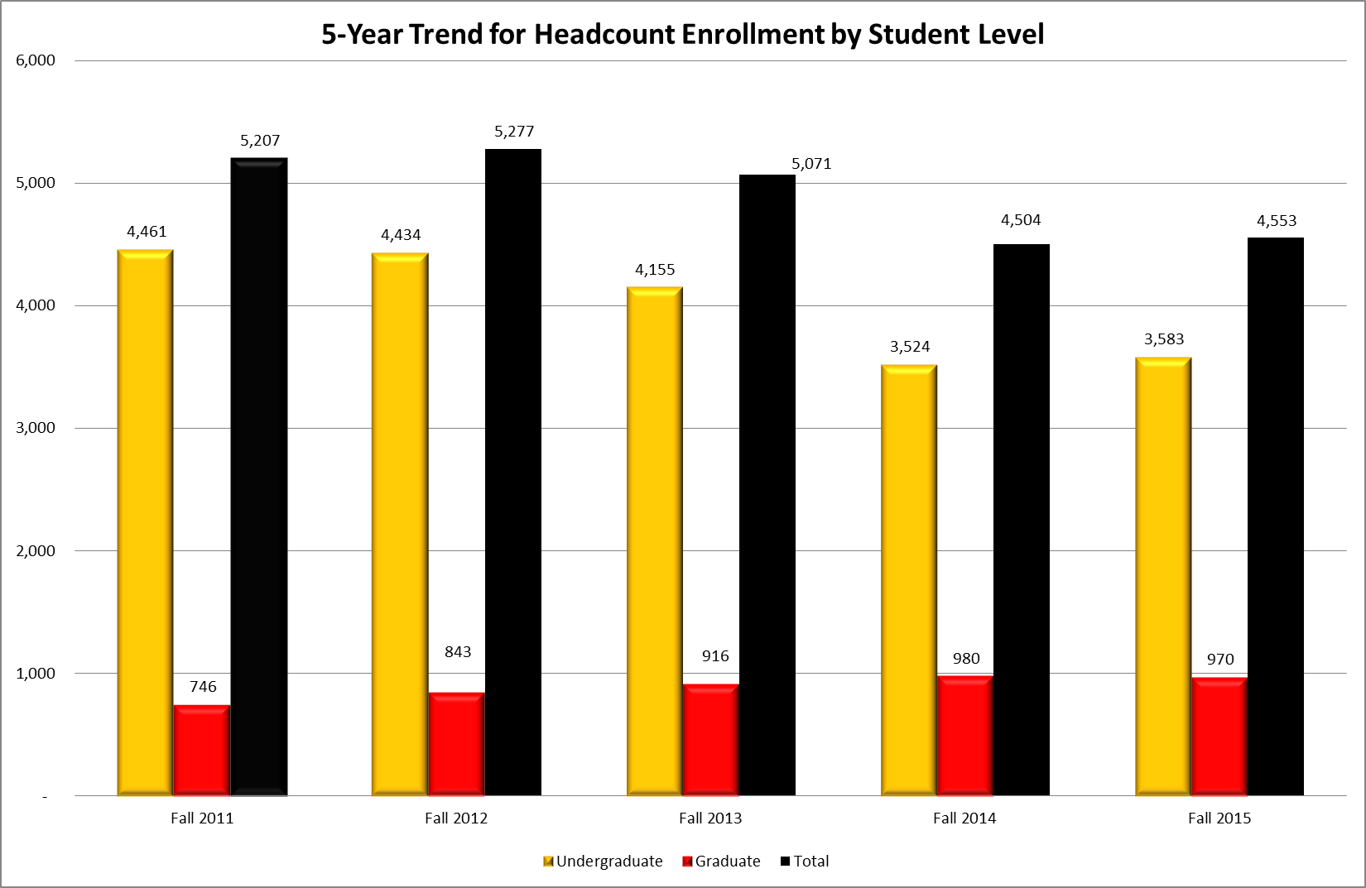
5-Year Trend for Headcount
Enrollment by Student Level

Slide 4
FYs 2009 – 2016
Annual Student Tuition & Mandatory Fees

Slide 5
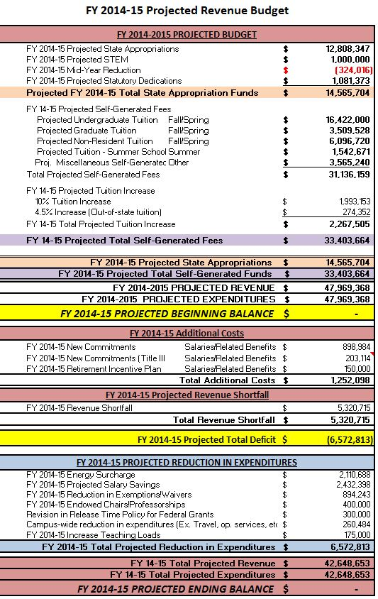
FY 2014-2015
Projected Revenue Budget

Slide 6
FY 2015-2016 Projected Revenue Budget

Slide 7
University of Louisiana System
Mid-Year General Fund Budget Reduction

Slide 8
University of Louisiana System
Mid-Year General Fund Budget Reduction (cont’d)
The impact of a $38 million budget cut in January would severely hinder, if not cripple our institutions. This will further erode the already strained financial position of each institution, deemed critical in the SACS COC reaffirmation process. Each institution has a specific and unique methodology to implement the reduction. The list of actions and concerns is not limited to the following:

Slide 9
University of Louisiana System
Mid-Year General Fund Budget Reduction (cont’d)
A reduction of this magnitude will cause a number of institutions to declare financial exigency
Severely impacts SACS Accreditation
Reduce salaries and benefits through hiring freeze except for most mission-critical positions
Layoff probational staff the remainder of fiscal year
Freeze hiring on vacant classified and unclassified positions

Slide 10
University of Louisiana System
Mid-Year General Fund Budget Reduction (cont’d)
Furlough non-tenured faculty as well as both unclassified and classified staff
Loss of instructional classes and potential loss of accreditation
Loss of degree programs
The impacts on positions not being filled will negatively affect the ability to serve students and will affect retention, recruiting, and graduation
Services to students and the university communities will be negatively impacted

Slide 11
University of Louisiana System
Mid-Year General Fund Budget Reduction (cont’d)
Limit educational, field and professional travel opportunities for students and faculty
Essential operating services for maintenance, software and printing to meet instructional, research and other critical needs will be substantially limited for the remainder of the fiscal year
Reduce scholarships/waivers by freezing student retention grant support
Increase faculty teaching loads

Slide 12
University of Louisiana System
Mid-Year General Fund Budget Reduction (cont’d)
Reduce the number of courses taught for the spring and summer semester
Withhold budgeted merit increases for faculty and staff

Slide 13
Grambling State University
Budget Reduction Task Force
Short Term Solutions

Slide 14
Grambling State University
Budget Reduction Task Force
Long Term Solutions

