Slide 1

Frequently Asked Questions ( Parent Edition)
Office of Student Conduct

Slide 2
What is student conduct?
The Office of Student Conduct serves the University community by administering the student judicial system. Anytime a student has violated the Code of Student Conduct, his/her case will be referred to this office.

Slide 3
At what point, or under what circumstances, will I be notified of my son/daughter’s judicial status?
In accordance with the Federal Family Educational Rights and Privacy Act of 1974 (FERPA), the University cannot contact or share information about a student’s judicial record without the student’s written permission. However, the 1998 amendment (SEC. 952) allows the university to contact parents for students who are responsible for violating the alcohol or drug policy.

Slide 4
Since I pay for my son/daughter’s tuition/housing/etc., shouldn’t I have the right to know about any trouble he or she may get into?
The Director of Student Conduct is always available to discuss general information about the discipline process, University regulations, and related laws. It is important to know that federal laws prohibits staff from releasing any information about a student’s involvement in the disciplinary process without the student’s written permission, even to family members (i.e. mother, father, etc.)

Slide 5
How can parents help their son/daughter who has been accused of a code violation?
Some students want direct family involvement for emotional support, case preparation, advice, and decision-making. These students may wish to have a family member serve as their advisor. Occasionally, a student may not want to inform family members about his or her involvement in the disciplinary process. Parents who are contacted by their son/daughter about pending disciplinary actions may want to suggest that the student sign an authorization (i.e., Release of Information form) allowing the director to talk with their parents about the case.

Slide 6
Should my son/daughter have an attorney?
A student may have legal advisor accompany him/her to a hearing before the campus judicial board. The legal advisor may or may not represent the student (see new policy ACT NO. 464 and Code of Student Conduct), only advise him/her. Students who retain an attorney do so at their own expense.

Slide 7
What does a HOLD on my son/daughter’s account mean?
A hold is placed by the Director of Student Conduct to block registration, graduation, or issuance of a diploma until a disciplinary matter has been resolved. Once the matter is resolved, the hold will be lifted. Questions pertaining to a disciplinary hold should be directed to the Director of Student Conduct.

Slide 8
My son/daughter is also in trouble with the courts. Can the campus proceedings b delayed until the conclusion of the criminal process?
Student Conduct is obligated to move forward with all disciplinary matters as soon as it has collected sufficient information to do so. The University is not required to defer to the timeline of the criminal courts and will not typically grant request made on this basis. Please remember that the University is not attempting to determine if a student committed a crime… only to determine whether or not the Code of Student Conduct has been violated.

Slide 9
The police officer/staff member said that my son/daughter wouldn’t get in trouble. Why is Student Conduct pursuing this incident?
Many students allege that staff has assured them they “will not get in trouble,” The fact is that only Student Conduct has the authority to determine whether or not a violation of the Code of Student Conduct may exist, and therefore whether or not to pursue the incident.

Slide 10
What sanctions may be imposed by the University?
Sanctions are only imposed if a student has been found responsible for a violation of the Code of Student Conduct. The primary goals of sanctions are to protect the safety of the University community, to educate students about the inappropriateness of their conduct, and to provide opportunities to learn new behaviors and problem-solving techniques. Sanctions are designed to reflect the individual student and the impact of the violation (s) on the campus community.

Slide 11
Can my son/daughter be held accountable by the University for an incident that took place off campus?
Yes. The University reserves the right to assert jurisdiction for any incident (s) that take place off campus. Students may be taken before a University judicial body for any conduct that is deemed violative of this code, and for any conduct and/or behavior that reflects negatively on the image or reputation of the University.

Slide 12
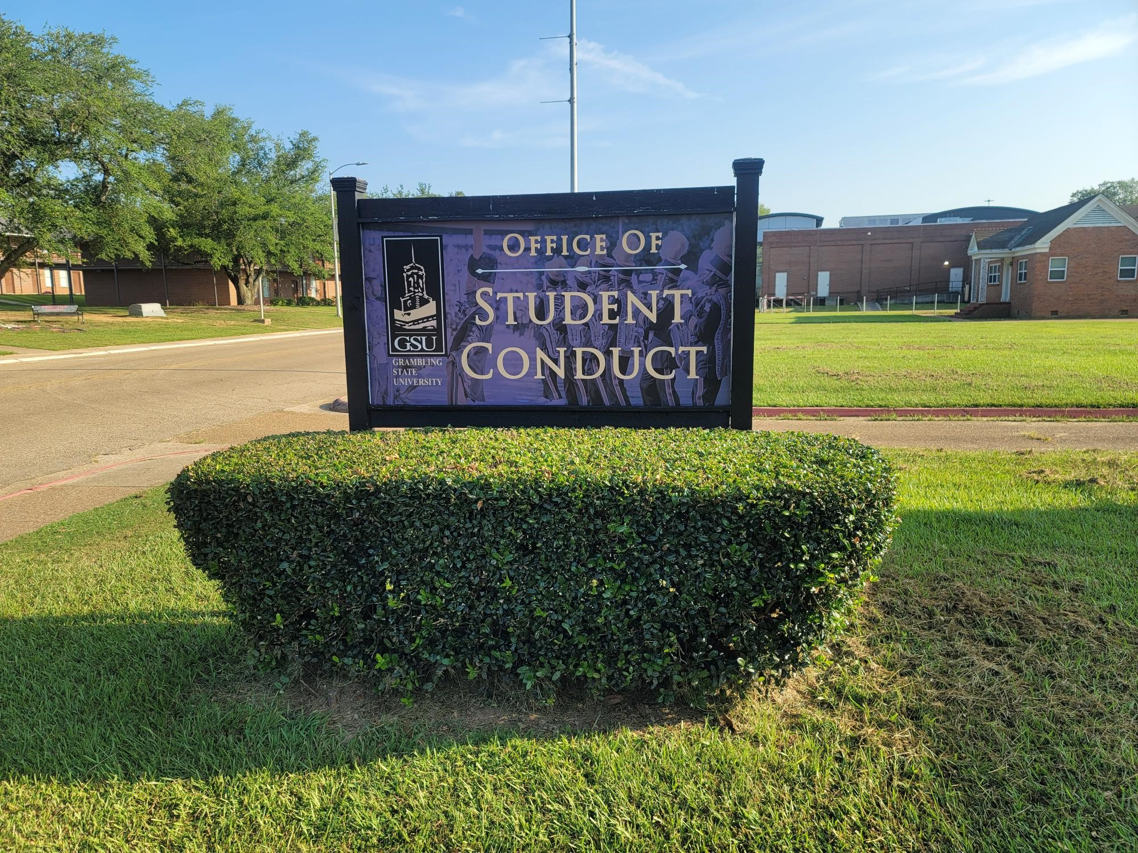
Thank you, Office of Student Conduct!

Slide 13
Grambling state
University
Where everybody is somebody

