Slide 1
Grambling state university office of student conduct
Who we are and how we can help

Slide 2
Mission statement
The primary mission of the Office of Student Conduct is to support the larger mission of both the University and the Division of Student Affairs. The Office of Student Conduct seeks to promote student learning, growth and development by increasing student awareness of the University’s expectations of behavior, both inside and outside the classroom by collaboratively working with other departments in an effort to create a safe, secure, and civil environment conducive to learning.

Slide 3
Departmental purpose
The purpose of the Office of Student Conduct is to ensure that students will not be deprived of life, liberty or property, administer a fair student disciplinary process that adheres to prescribed standards and to establish guidelines and rules to ensure that students maintain appropriate behavior at the University and off-campus. The Code of Student Conduct creates an expectation of behavior that the Institution deems acceptable. It is each student's responsibility to adhere to the policies and standards of conduct prescribed by the University, the Board of Supervisors for the University, as well as those established by local, state and federal laws. The University publishes rules, regulations and policies concerning acceptable student behavior in the Code of Student Conduct.

Slide 4
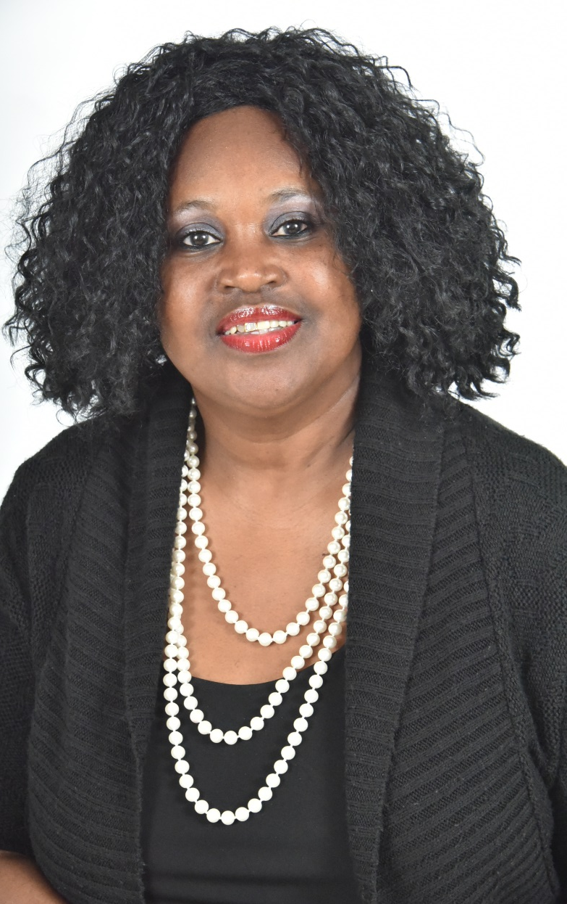
Our staff
Inetha Wimberly
Director
Office of Student conduct
wimberlyi@gram.edu
318.274.7782

Slide 5
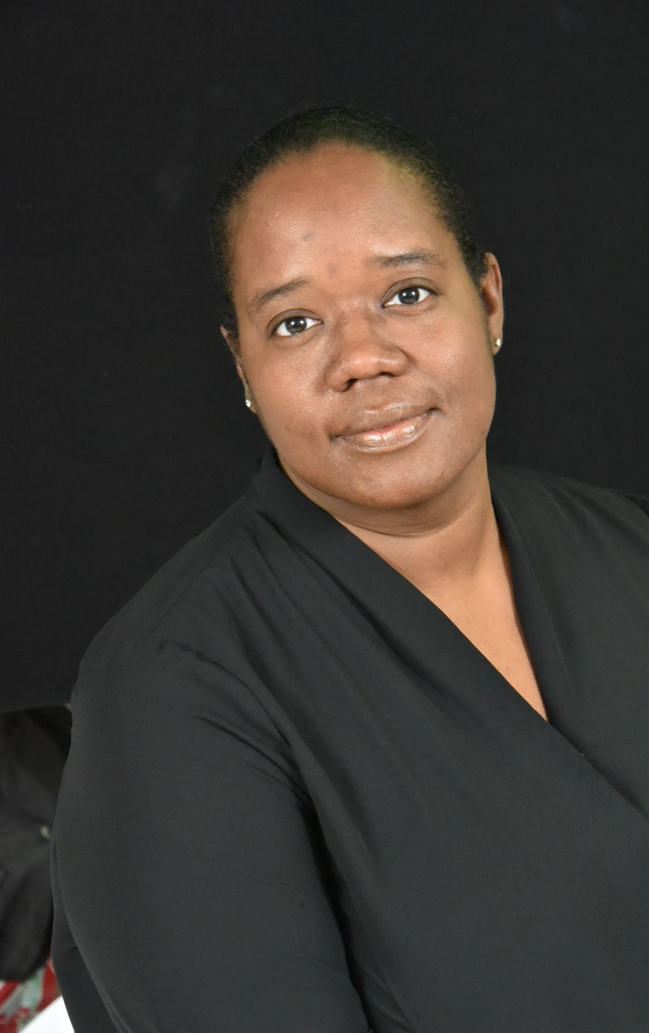
Our staff
Demetria Shelton
Staff support
Office of student conduct
sheltonde@gram.edu
318.274.3169

Slide 6
goals
To facilitate a process that promotes student development by challenging and supporting students owning individual responsibility;
To use educational strategies and disciplinary counseling as a catalysts for self-understanding and personal growth;
To enforce a system characterized by accountability, compassion, and increased civility; and
To promote a safe, orderly and positive University climate through informational programming, training, and intervention efforts.

Slide 7
what student conduct programs are available for students, faculty, and staff?
Student conduct overview
PDR (Program for Dispute Resolution
Classroom management
This program provides an introduction to the student code of conduct
This program is appropriate for students willing to voluntarily engage in a mediation session with a trained mediator to resolve outstanding conflicts (e.g., roommate v. roommate, tenant v. landlord, property damage, etc.). Please note that mediation is not a sanction and a student may not be sanctioned to participate in a mediation session. For additional information regarding the PDR program, please contact Student Conduct.
This program focuses on helping faculty manage disruptive classroom situations. Topics covered include applying the student code of conduct and tips for effective classroom management

Slide 8
what student conduct programs are available for students, faculty, and staff? cont.
Campus outreach:
Campus outreach activities are conducted with various departments to increase awareness of the university’s expectation of acceptable student behavior

Slide 9
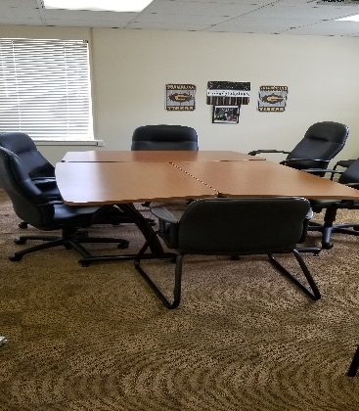
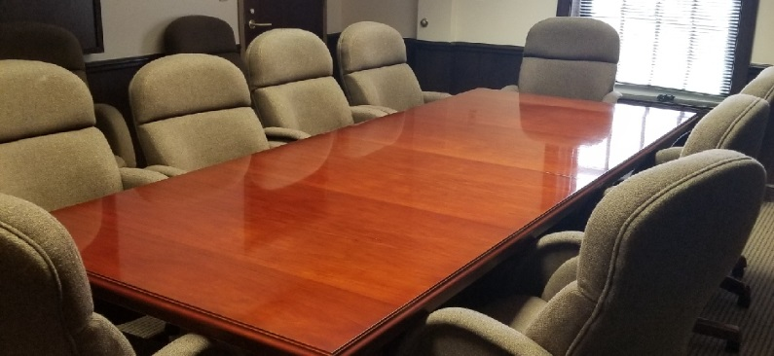
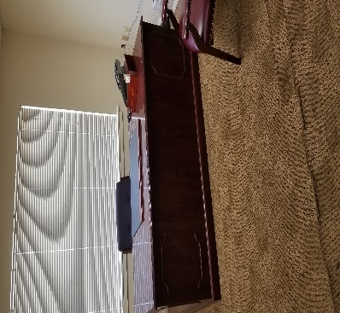
University judicial board member (UJB)
Administrative appeals board (AAB)
Graduate judicial assistants
The UJB consists of faculty, staff and students appointed by the Director of student conduct. The Judicial board is the primary judicial body of the university. It has original jurisdiction over all cases referred to it by appropriate university officials. Members serve as representative on the judicial board and hear student cases involving allegations of misconduct.
The aab consist of faculty and staff appointed by associate dean of student service to consider an appeal from the judicial body’s determination for readmission to the office of the vice president for student affairs
Students gain exposure to the day-to-day operations of the office and learn about national trends and practices related to student discipline work. Interns will have the opportunity to develop programs and fulfill academic credit.

Slide 10
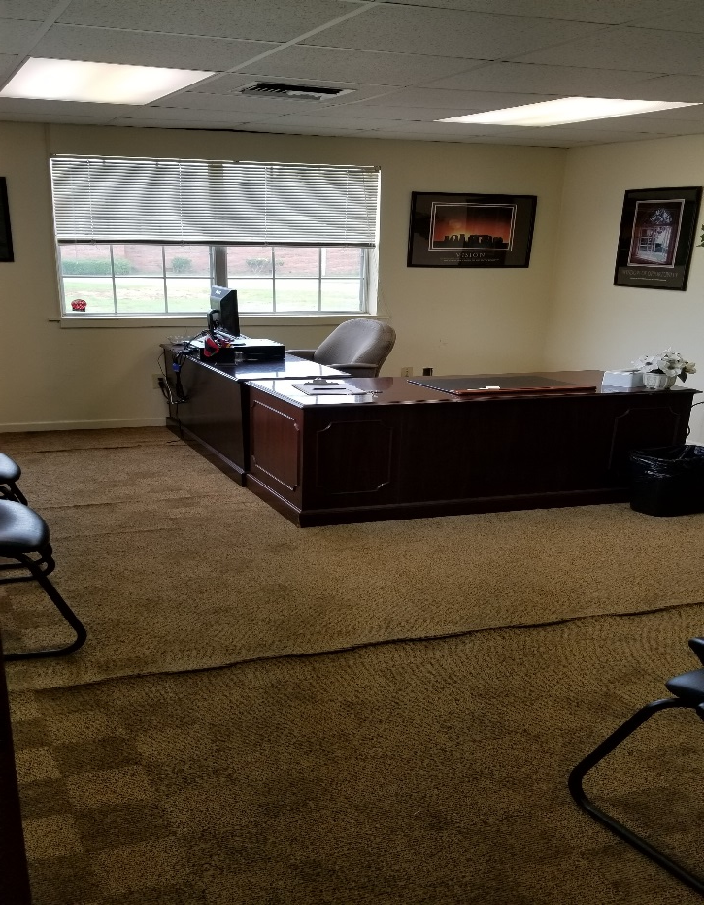
Student work study
Students assist with day-to-day operations of the office.

Slide 11
How to file a complaint against a student for an alleged misconduct?
first
second
Third
Student misconduct complaints must be referred in writing to the office of student conduct
Incident report should be completed and are available at:
www.gram.edu
student life
Student conduct
Incident report
Notify university police or any administrator to assist with the process. Specific procedures for referring a complaint are outlines in the stud

