Slide 1
“A New Beginning”

Slide 2
Living in Tiger Land is an integral part of the University experience. There are five traditional style residence halls and nine apartment style housing options on the Grambling campus which house approximately 2,500 students each year. The smallest residence hall houses 25 students and the largest more than 250. Residence halls are grouped as follows:
Female Halls: Jewett, Hunter, Robinson, Tiger Village Truth, Douglass, Wheatley, Bowen
Male Halls: Garner, Tiger Village Attucks, Holland, Knott, Pinchback, Bethune
Co-Ed Halls: Tiger Village Jones, Tubman, Adams, Richmond, Steeple’s Glen

Slide 3
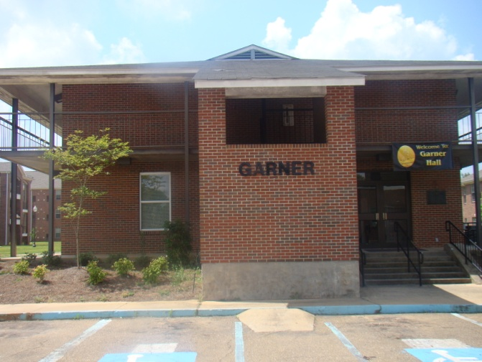
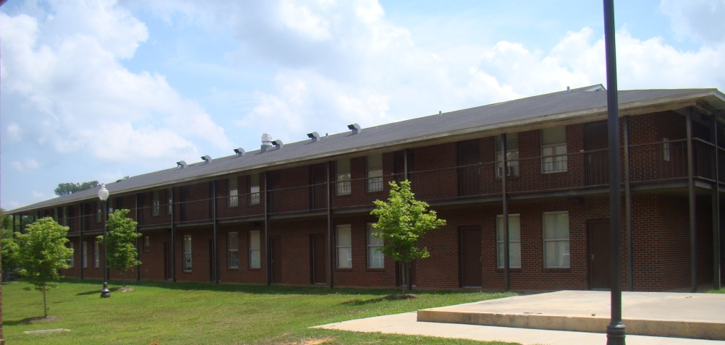
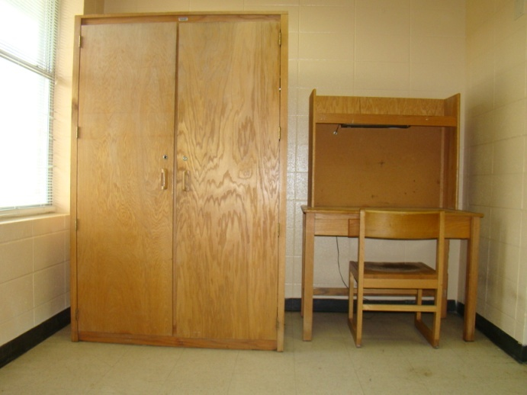
Garner Hall
Each room has the following:
2 twin size beds
2 desk & chairs
2 nightstands
2 armoires
Roommates share the following:
cable connection
internet connection
basic phone connection
Suitemates share the following:
1 toilet
1 showers
2 sinks
traditional, double occupancy/suite style, all male residence hall. It is located on Hutchinson Street across from Dunbar Hall. Garner Hall is a two story building that houses 76 students. There is no classification requirement for this assignment.

Slide 4
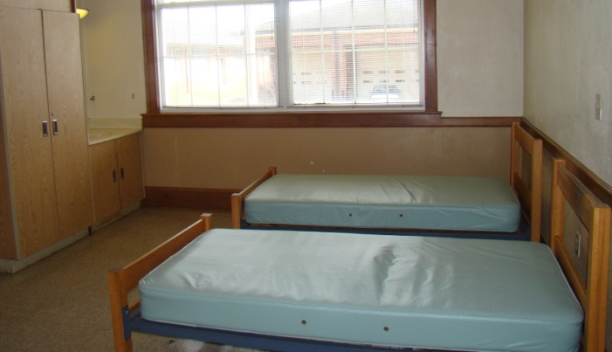
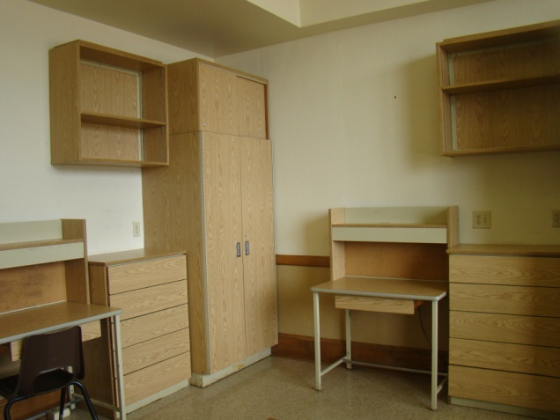
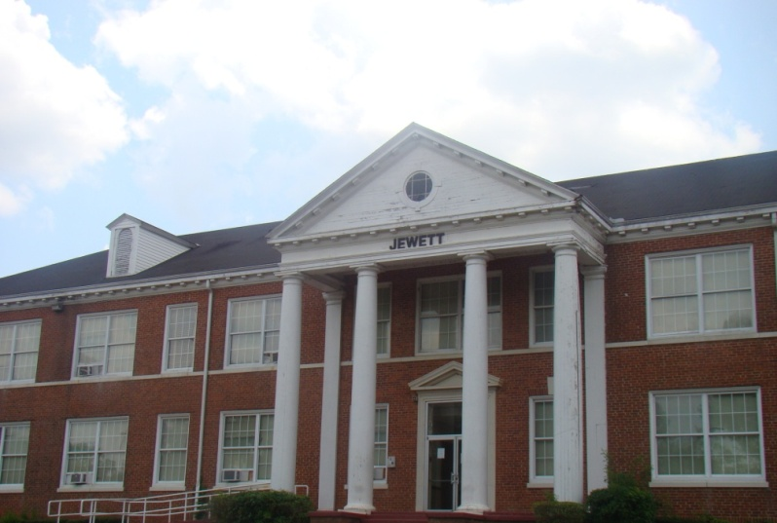
Jewett Hall
traditional, double occupancy, all female residence hall, with community showers/bathrooms. It is located in the heart of campus, next to Grambling Hall. Jewett Hall is a two story building that houses 58 students. There is no classification requirement for this assignment.
Each room has the following:
2 twin size beds
2 desks
2 nightstands
2 closets
Roommates share the following:
sink
cable connection
internet connection
basic phone connection

Slide 5
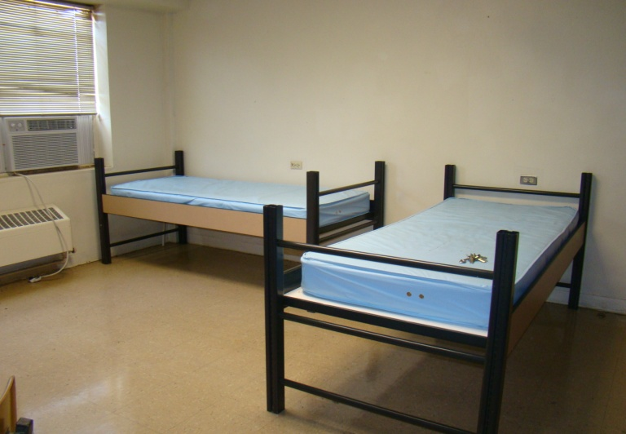
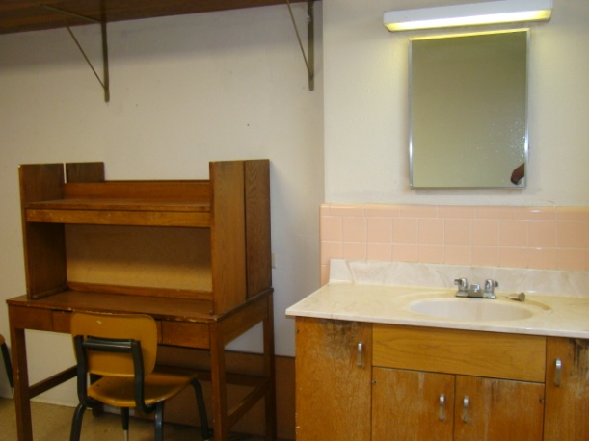
Jeanes Hall
Each room has the following:
2 twin size beds
2 desks
2 nightstands
2 closets
Roommates share the following:
sink
cable connection
internet connection
basic phone connection
traditional, double occupancy, all male residence hall, with community showers/bathrooms. It is located on R.W.E. Jones Drive, across from Jacob T. Stewart Hall. Jeanes Hall is a two story building that houses 100 students. There is no classification requirement for this assignment.

Slide 6
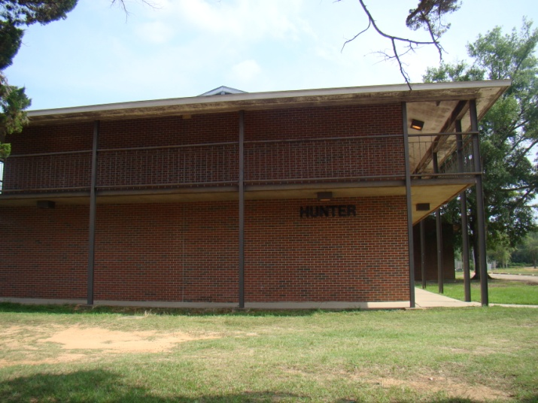
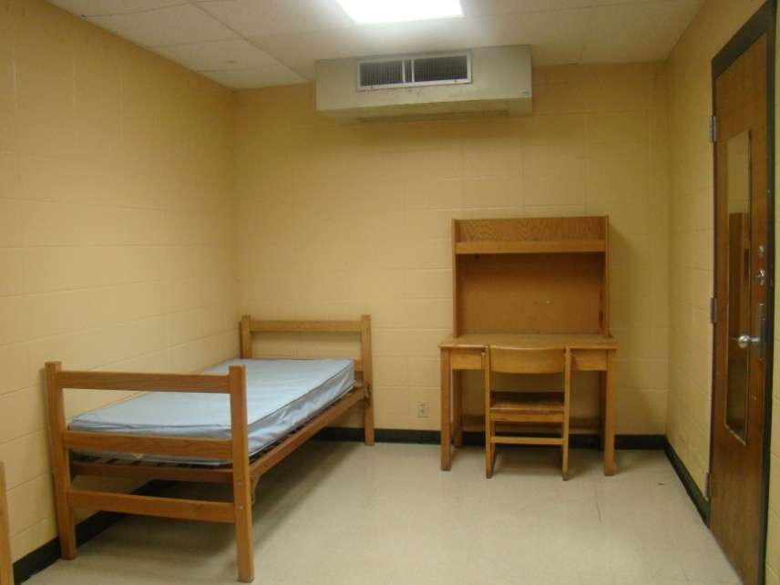
Hunter Hall
traditional, double occupancy/suite style, all female residence hall. It is located on Main Street across from the Favrot Student Union. Hunter Hall is a two story building that houses 92 students. There is no classification requirement for this assignment.
Each room has the following:
2 twin size beds
2 desk & chairs
2 nightstands
2 armoires
Roommates share the following:
cable connection
internet connection
basic phone connection
Suitemates share the following:
1 toilet
1 showers
2 sinks

Slide 7
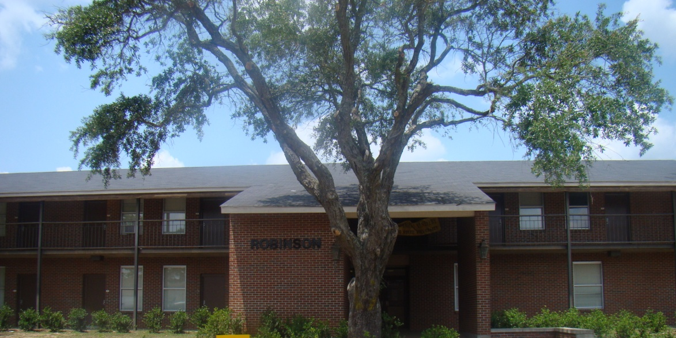
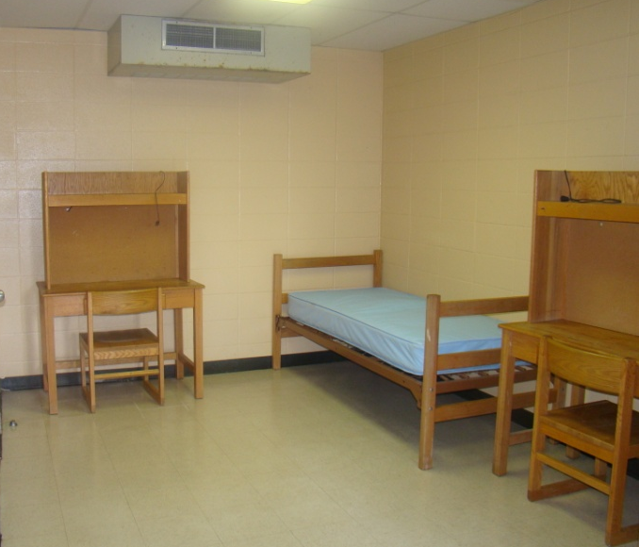
Robinson Hall
traditional, double occupancy/suite style, all female residence hall. It is located on Main Street across from the Favrot Student Union. Robinson Hall is a two story building that houses 72 students. There is no classification requirement for this assignment.
Each room has the following:
2 twin size beds
2 desk & chairs
2 nightstands
2 armoires
Roommates share the following:
cable connection
internet connection
basic phone connection
Suitemates share the following:
1 toilet
1 showers
2 sinks

Slide 8
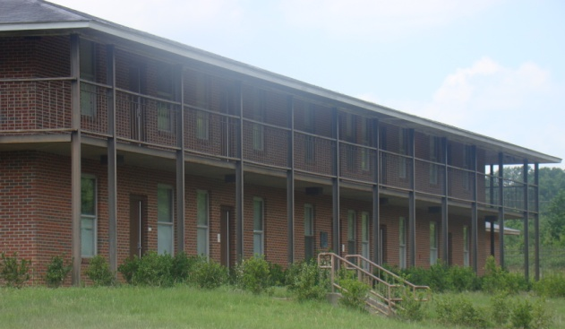
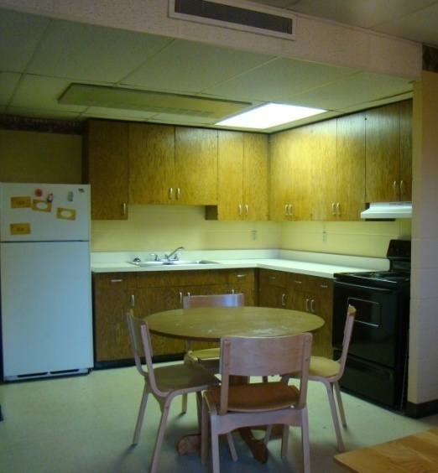
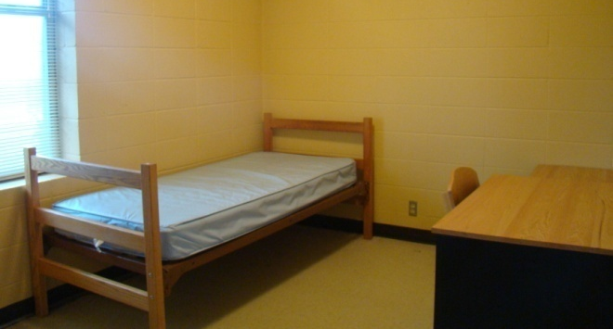
Richmond Hall
co-ed, two-story apartment style facility with 2 bedroom/1bath apartments and 1 bedroom/1bath apartments. Located off of Facilities Drive, Richmond is home to 25 upperclassmen residents.
Each bedroom has the following:
twin size bed
nightstand
closet
basic phone connection
cable connection
wireless internet connection
Each apartment style unit shares the following:
kitchen (cabinets, refrigerator, sink, stove, table, chairs)
living room (sofa, chair, entertainment center, coffee table, end table, basic phone service, cable connection)
bathroom (shower/tub, toilet)

Slide 9
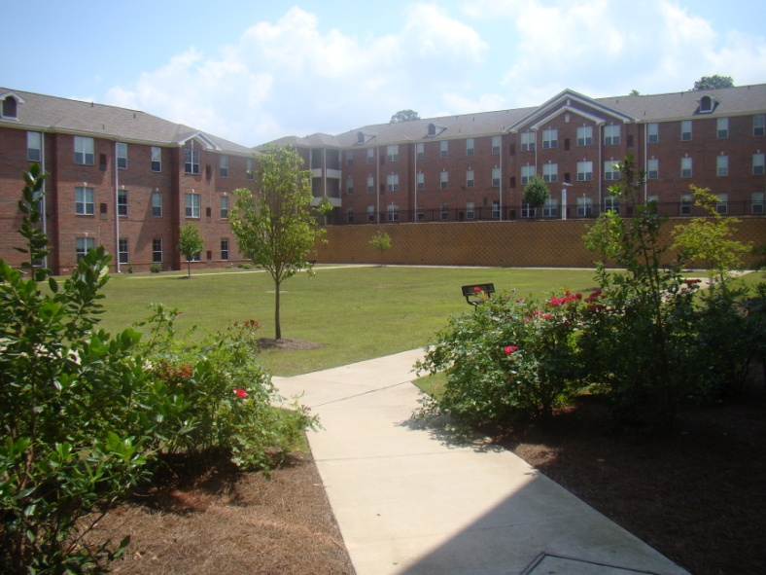
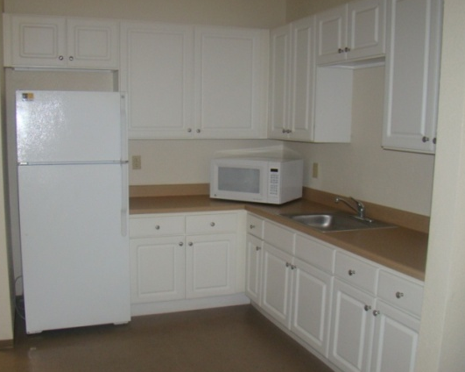
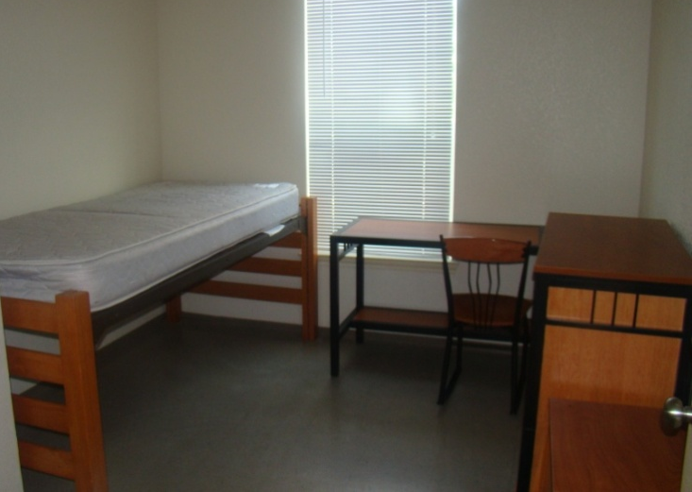
Tiger Village Jones, Truth, Tubman, Adams & Holland
Each bedroom has the following:
twin size bed
desk & chair
nightstand
dresser
closet
basic phone connection
cable connection
wireless internet connection (Ethernet optional)
Each apartment style unit shares the following:
bathroom (shower/tub, toilet)
double sink area
kitchenette (cabinets, refrigerator, sink, microwave)
living room (sofa, chair, entertainment center, coffee table, end table, basic phone service, cable connection)
apartment style residence halls featuring 2 bedroom/1 bath and 4 bedroom/2 baths. Located on R.W.E. Jones Drive, these facilities are three-story buildings that house 94-190 students per building. These buildings are for upperclassmen only.

Slide 10
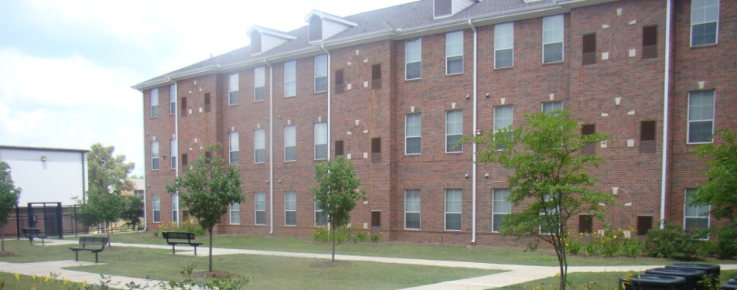
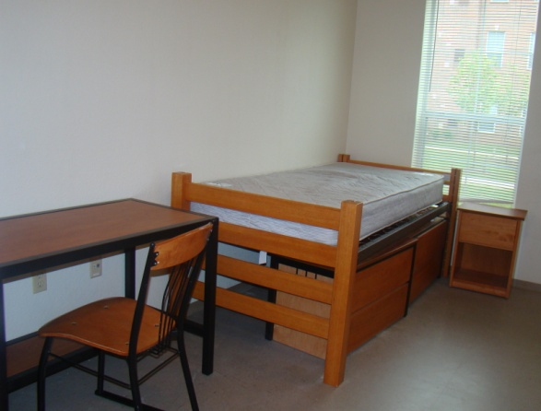
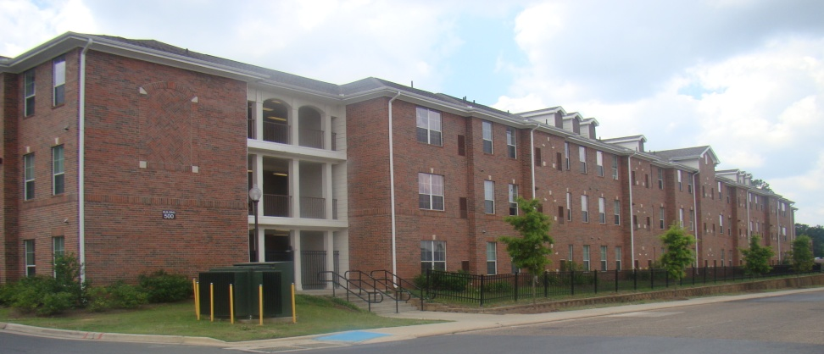
Tiger Village Knott & Bethune
Each bedroom has the following for each resident:
twin size bed
desk & chair
nightstand
dresser
closet
sink
Roommates share the following:
cable connection
internet connection
basic phone connection
bathroom (shower/tub, toilet)
all male and female, double occupancy, traditional style residence halls. Located on Central Avenue and Younger Street near the Intramural Center, these facilities are three-story buildings that houses 192-216 students. There is no classification requirement for this assignment.

Slide 11
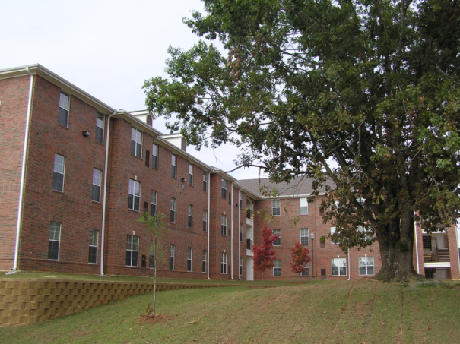
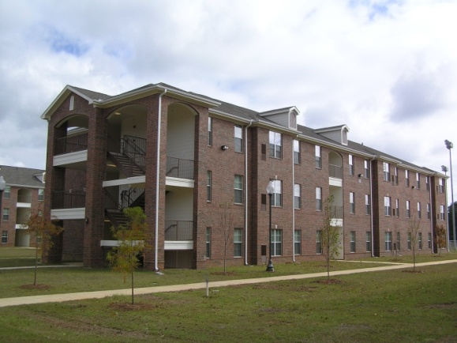
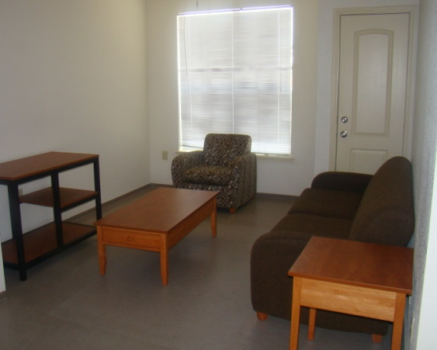
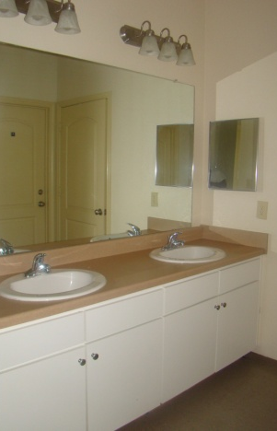
Tiger Village Pinchback & Bowen
Each bedroom has the following:
twin size bed
desk & chair
nightstand
dresser
closet
basic phone connection
cable connection
wireless internet connection (Ethernet optional)
Each apartment style unit shares the following:
bathroom (shower/tub, toilet)
double sink area
kitchenette (cabinets, refrigerator, sink, microwave)
living room (sofa, chair, entertainment center, coffee table, end table, basic phone service, cable connection)
apartment style residence halls featuring 2 bedroom/1bath and 4 bedroom/2 baths. Located on Younger Street and Hutchinson Street, these facilities are three-story buildings that house 85-170 students. These buildings are for freshmen only.

Slide 12
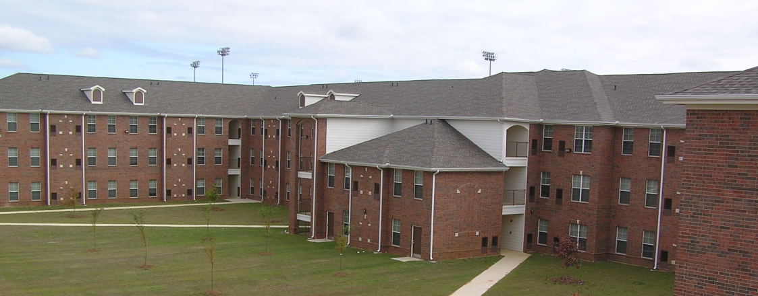
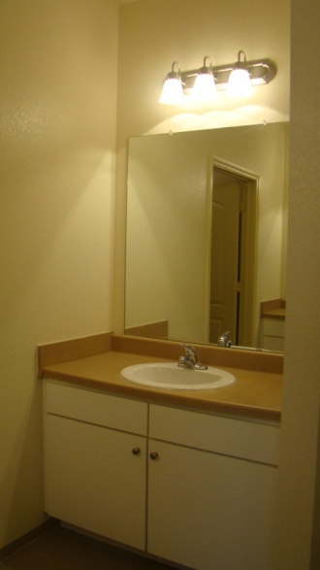
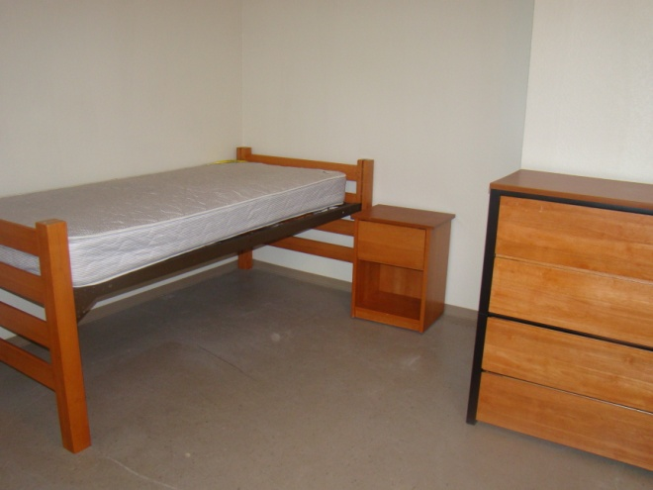
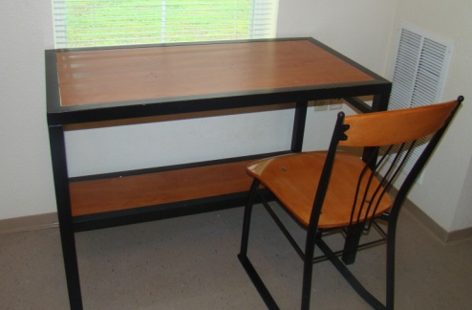
Tiger Village Douglass & Wheatley
All male and female double occupancy, traditional style residence halls, located on Sandle Street, these facilities are three-story buildings that house 248-274 students. These buildings are for freshmen only.
Each bedroom has the following for each resident:
twin size bed
desk & chair
nightstand
dresser
closet
sink
Roommates share the following:
cable connection
internet connection
basic phone connection
bathroom (shower/tub, toilet)

Slide 13
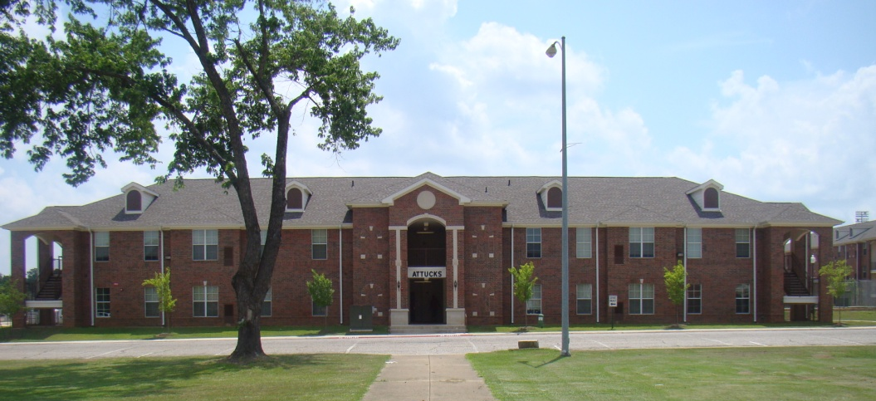
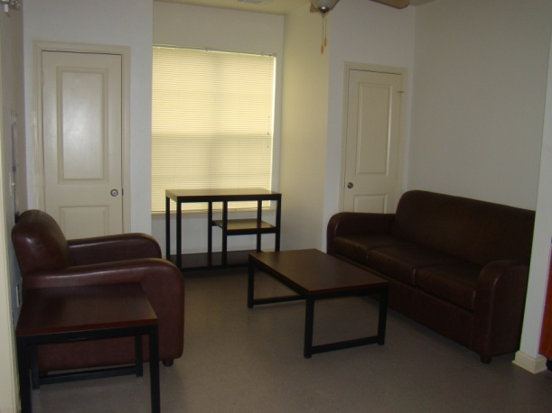
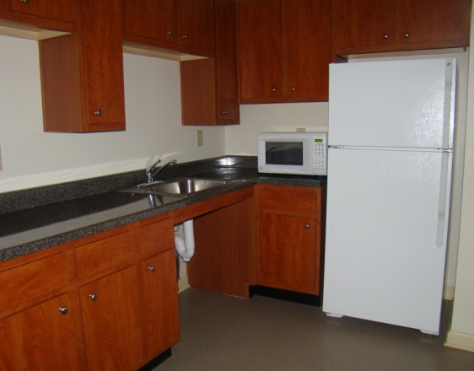
Each bedroom has the following:
twin size bed
desk & chair
nightstand
dresser
closet
sink
basic phone connection
cable connection
wireless internet connection (Ethernet optional)
Each apartment style unit shares the following:
bathroom (shower/tub, toilet)
kitchenette (cabinets, refrigerator, sink)
living room (sofa, chair, entertainment center, coffee table, end table, basic phone service, cable connection)
crispus Attucks
all male, apartment style residence hall featuring 4 bedrooms/2baths only. Located on Sandle Street, this facility is a two-story building that house 37 students. This building is for freshmen only.

Slide 14
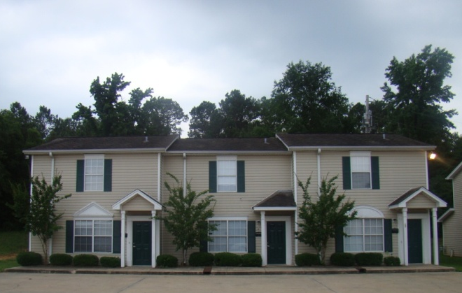
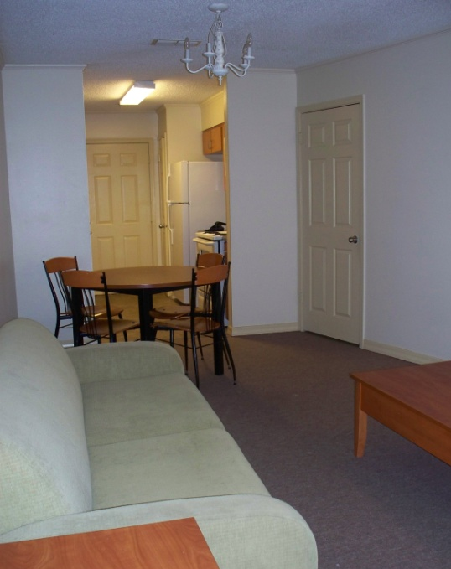
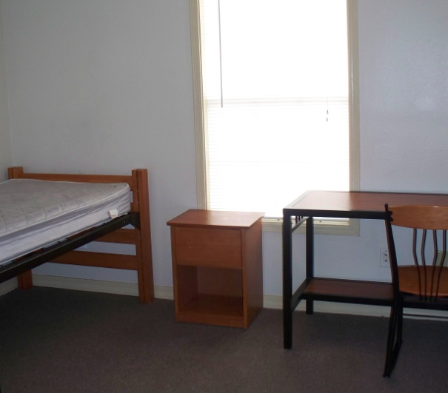
Steeple’s Glen
Each bedroom has the following:
twin size bed
bathroom (shower/tub, toilet)
desk & chair
nightstand
dresser
closet
basic phone connection
cable connection
wireless internet connection (Ethernet optional)
Each apartment style unit shares the following:
washer & dryer
kitchen (cabinets, refrigerator, sink, stove)
living room (sofa, chair, entertainment center, coffee table, end table, basic phone service, cable connection)
co-ed, apartment style facility featuring four bedrooms only. This complex is located at the corner of Maxie Street and Central Avenue. These two-story complexes house 48 upperclassmen residents.

Slide 15
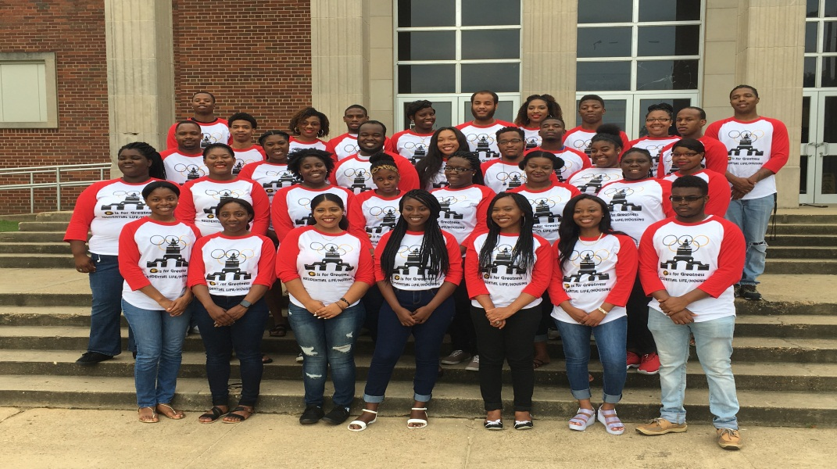
Additional Advantages
Cost effective
Live closer, sleep later
Resident Assistants
Residence Life Cinema
Living and Learning Community

Slide 16
Room Rates
2017-2018
Room and meal plan costs are per semester/per person
$1560.00—Traditional Rooms (Garner, Jewett, Hunter, Robinson)
$2434.00—Richmond Hall (2 bedroom/1 bath)
$2578.00—Richmond Hall (1 bedroom/1 bath)
$2740.00—Tiger Village double occupancy
$3250.00—Tiger Village 4 bedroom apartment style
$3548.00—Steeple’s Glen 4 bedroom apartment style
$3758.00—Tiger Village 2 bedroom apartment style
Summer School
$639 Housing per Session
$395 Meal Plan per Session
$7.50 Mail box fee per session
Additional Costs
$50.00—Non-refundable application fee
$150.00—Room reservation fee (priority deadline: July 1st)
$1777.00—Meal plan (all on-campus students are required to purchase a meal plan)
$20.00—Mailbox fee (all on-campus students are required to rent a mailbox)

Slide 17
Contact Us
Office
Online
Mailing Address: 403 Main Street P.O. Box 540 Grambling, LA 71245
Physical Address: Grambling Hall Suite 216
Phone: 318-274-2504
Fax: 318-274-4004
Webpage: www.gram.edu/housing
Email: gsuhousing@gram.edu
Twitter: gsureslife
Facebook: Grambling State University Department of Residential Life/Housing

