Slide 1
Connecting Talents
To
Images
A Work Study Training
Sponsored by the Departments of Human Resources,
Career Services, Grambling Achievement Resource Program,
Financial Aid, and Center for Student Professional Development

Slide 2
Objectives
Understand roles/responsibilities of Supervisor/Student.
Bring an awareness to the desired image of Grambling State University.
To improve student preparedness for future endeavors.
To understand effective office policies and procedures.
Teach an awareness for different personalities and how to manage them.
To enhance communications skills.
Teach recognition of behavior that may give the wrong message for the University and individual.

Slide 3
What Will Be Gained?
Information needed to manage and perform in an office efficiently.
Confidence in knowing how to interact with people with different views, cultures, and personalities.

Slide 4
Program Content
Introduction – The Need For Training
Supervisor’s Role
Supervisor -When the Student First Arrives to Departments
Schedule
Job Description/Responsibilities(See Examples)
Policies(Confidentiality, payroll, attendance, evaluation)
Student Training – Topics
Student Self Awareness
Communication

Slide 5

Program Content Cont’d
Office Etiquette(Manners)
Cell phone use in the work place.
Dressing for the Office.
Ethical Behavior in the Work Place.

Slide 6

Supervisor’s Role
  It is the role of the Supervisor to ensure that each student worker adheres to the rules that are set in place for all student workers. No workers should be exempted from any of these policies for any reason.

Slide 7
When the Student First Arrives.
Schedule – Each Supervisor must have the student complete a schedule so all involved will know when to expect them. Reminder, students should not be scheduled to work when they have a class.
Job Description/Responsibilities – Each student should be given a list of duties that they are to perform daily. Please also state that duties may change as office needs change. (See examples of job descriptions enclosed.
Policies –(There may be others that are unique to a given office)
  Theft
  Falsification of timekeeping records or any other records

Slide 8
When student first arrives cont’d.
Policies cont’d
  Abuse of alcohol
  Working under the influence of illegal drugs.
  Possession, distribution, sale, transfer, or use of illegal drugs in the workplace, while on duty, or while operating employer-owned vehicles or equipment.
  Fighting or threatening violence in the workplace.
  Boisterous or disruptive activity in the workplace.
  Any behavior that may cause damage to University property.
  Insubordination or other disrespectful conduct.
  Violation of safety or health rules.

Slide 9
When student first arrives cont’d.
Policies cont’d.
  Smoking in prohibited areas.
  Unlawful discrimination, sexual or other unlawful or unwelcome harassment.
  Violation of University Responsible Computer Use policy.
  Possession of dangerous or unauthorized materials, such as explosives or firearms, in the workplace.
  Excessive absenteeism or any absence without notice.
  Excessive tardiness.
  Unauthorized absence from work station during the work day.
  Unauthorized use of telephones, mail system or equipment.

Slide 10

When student first arrive cont’d.
Policies cont’d.
  Unauthorized disclosure of confidential information.
  Violation of personnel policies
  Personnel information released without permission of person.

Slide 11
Student Self Awareness
The Idea of a Positive Self
Be true to yourself – Live your life doing what feels right to you, not what someone else thinks you should do. It’s ok to listen to advice, but in the end, make the decision that feels best for you.
You are responsible for your own happiness.
Stop comparing yourself to others. You are not suppose to be like anyone else. You are the only one that can be you.
Create an uplifting environment for yourself.
Celebrate your successes, even the small ones. Any progress is worthy of celebration.

Slide 12

Self cont’d
Spend time with supportive, uplifting people.
Allow yourself to be where you are. Feel whatever you are feeling, without judging it or judging yourself for feeling it.
Don’t limit your self. You must realize that no one can limit you but your self.

Slide 13
Communication
What constitutes good customer service?
  Reliability
  Confidence
  Empathy
  Responsiveness
  Why is good customer service so important?
  “First impressions are marked on the fabric of the mind.” Our goal is to create a positive experience for every customer.
  Who are our Customers?

Slide 14
Communication cont’d
External
  Prospective students
  Parents
  Other interested parties
  Internal
  Staff
  Faculty
  Students
  A Self-fulfilling Prophecy – Good customer Services = Better Customer Experiences = Increase in Enrollment and Better Services.

Slide 15
Communication cont’d.
You make the statement, - “But my degree or my purpose for being here isn’t to work in Public Relations?
You must remember that you come into contact with customers every where. YOU ARE THE FACE OF GSU.
YOU ARE GRAMBLING STATE UNIVERSITY!!

Slide 16
Communication cont’d.
Quick Check
What is good customer service?
Who are our customers?
Why is good customer service so important?

Slide 17
Communication Skills
What are the costs of ineffective communication?
  Lost opportunities
  Mistakes/rework
  Confusion/mistrust
  Barriers to Effective Communication
  Environmental
  Verbal
  Interpersonal

Slide 18
Communication Skills cont’d.
Environmental – parts of your surroundings that have a negative effect on communication.
Verbal – Ways of speaking that get in the way of good communication.
Interpersonal – relationship issues between people that have a negative effect on communication. (stereotypes, hot buttons, attitude)

Slide 19
Ways to Overcome Barriers
Environmental
  Control the setting
  Plan to talk when there are minimal disruptions.
  Verbal
  Know what you want to say and be clear.
  Ask questions and confirm
  Listen
  Interpersonal
  Set aside biases and assumptions
  Be alert for possible differences in perceptions.

Slide 20
Scenario
You are sitting at a desk. In walks a student that lives in your dorm. You were dating the same guy last semester. She sees you and snaps her lips and walks up to you. She asks, “what do you know about my finances?”
What do you say? What questions would you ask? And if she does not accept your answer what would do?

Slide 21
Hearing vs. Listening
WHAT’S THE BIG DEAL?
Hearing is a physical process. The ears hear.
Listening is an intellectual and an emotional process. The whole body listens.
Hearing is a sense of sound. Listening is a search for meaning.

Slide 22
Hearing vs. Listening cont’d.
Why don’t we listen?
Interruptions
Fear of not having all of the answers.
Believing that you know more than the speaker.
The speaker pushes a hot button.
Active Listening
Confirm your understanding by repeating it.
Ask questions if you are unclear about anything.
Read back critical information to ensure that you got it right.

Slide 23
Top 10- Tips for Active Listening
Take Notes!
Be a CSI!
Stay calm!
Forget about the weekend – concentrate!
Listen for the unspoken!
Don’t be judgmental!
Let the caller know you understand!
Don’t interrupt…., unless you must!
It isn’t all about you!
Be prepared!

Slide 24
Quick Check
What are the three costs of poor communication?
Name three types of barriers to communication.
Name one way one can overcome barriers?
Give one reason why we do not listen?
Name two tips for active listening.

Slide 25

Phone Coverage
Scenario
You are working in the Office of Homeland Security. The Phone is ringing. What would you say?

Slide 26
Phone Coverage cont’d.
Offer a salutation
State the name of the department
Give your name(First name only, no nicknames.)
Offer assistance – How may I help you?
Grambling State University Greeting for answering the phone:
“Thank you for calling Grambling State University. My name is ________, how may I serve you?

Slide 27
What You Say and How on Phone
Let’s read these statements that are saying the same, but has a different tone:
Read them –
May I tell him who is calling, please?
Who’s calling?
1. May I ask what your call is in regard to?
Will she know who you are? What’s it regarding?
May I have her return the call?
What do you want?

Slide 28
Phone Coverage cont’d.
When the caller leaves a message.
Get the full name.
Date and time of call.
Company or department.
Phone number
The message.

Slide 29
Phone coverage cont’d.
What you cannot tell them.
Do not disclose information about a student to an external caller(Parents, other parties)
Do not give schedules, grades, ssn’s, financial aid information, etc.
WHEN IN DOUBT, DON’T GIVE IT OUT!!

Slide 30
Phone Coverage cont’d.
How to put a call on hold.
Ask permission FIRST.
Press the HOLD button.
To pick up again, press the extension button.
When you come back on the line, THANK THEM FOR HOLDING.
Do not leave a caller on hold more than 30 seconds without checking back.
Do not leave them on hold more than three minutes EVER.

Slide 31

Scenario
Handling an Angry Caller
The phone rings and the caller begins –

Slide 32
Handling an Angry Caller
Use the EAR method to calm an angry caller.
E – Empathize
A - Acknowledge/Apologize
R - Responsibility

Slide 33
Quick Check
1. What do you say when you answer the phone?
2. What information should you obtain when taking a message?
3. What are the steps for placing a caller on hold?
4. What is the EAR method for handling angry callers?

Slide 34
Office Etiquette(Office Manners)
Office etiquette or office manners is about conducting yourself respectfully and courteously in the office or workplace.
First impressions – You are the ambassadors of the business or office.
Always act with honesty and dignity.
Chewing gum and popping bubble gum in the presence of others is not dignified.
Do not cough or sneeze in anyone’s direction.

Slide 35
Office Etiquette cont’d.
The essence of good manners and etiquette is to be respectful and courteous at all times and with every body.
Knock before entering any ones office.
Don’t gossip about any co-worker.
Avoid sexist comments about a co-worker’s dress or appearance.
Take responsibility for your mistakes and go about correcting the mistakes.

Slide 36
Office Etiquette cont’d.
The boss always gets the benefit of the doubt. Don’t argue with the boss.
Office etiquette means being thoughtful when interacting with your peers.
Show consideration for other people’s feelings.
If there is conflict, do not get personal in your remarks.
It is extremely rude to arrive late for a meeting.

Slide 37
Office Etiquette cont’d.
Always be particularly respectful to those older than yourself even if they are junior to you in position.
Other things to remember.
Be on time for your job. Better still, be early.
Be respectful to your employer.
It’s ill-mannered to wear Ipod buds in your ears at work.
Keep your boss well informed in a timely fashion.
Respect all other employees.

Slide 38

Office Etiquette cont’d.
Cooperate with your employer. Cooperate with all employees.

Slide 39
Cell Phone Etiquette
More cell phone etiquette is needed than for any other type of communication device. If should be MUTED at the workplace.
Cell phones are often used where the conversation is not welcomed.
The following are some of the places and events where cell phones should be switched off or the ring tone muted.
1. On public transportation near other commuters.
2. In hospitals, restaurants, and shopping centers.
3. At checkouts, cinemas, and theatres.

Slide 40
Cell Phone Etiquette cont’d.
Train stations, bus stops and air ports.
Doctors office, churches, and conventions.
Waiting rooms, libraries, and lecture rooms.
At christenings, weddings, and funerals.
What causes the problems with cell phones is the annoying ring tone, shouting into the phone and airing one’s private life on the phone around others.
It is downright rude is to make a call in someone else’s company.

Slide 41
Scenario
Who can show us how we should not use the cell phone?
Who can show us how we should?

Slide 42
Dressing for the Office
Many things change, however, when it comes to dress, or appropriate dress does not.
It is apparent that some of us do not understand the difference between the Good, Bad, and Ugly.
A number of us do not understand where to wear certain outfits.
A party dress should not be worn to the office. What denotes a party dress.
Day clothes are far different from wearing after-five fashions.
Regardless of fashion trends, denim is casual and satin is formal.

Slide 43
Dressing cont’d.
A good public appearance involves more than looking good. It includes good grooming.
To you what is good grooming?

Slide 44
Dressing cont’d.
Have you taken a bath?
Are your nails clean?
Have your washed your face this morning?
Did you remember to use deodorant?
After vigorous activities, did you shower?
Is my hair clean?
What about my teeth?

Slide 45
Dressing cont’d.
There are many problems with not dressing for the right occasion. But for purposes of this training we are going to talk about the work place.
Most of you follow fads and should not. Some of the items are not flattering or appropriate for the occasion.
There are questions that we must ask ourselves prior to putting on an outfit.
How will this garment perform or function for where I am going?
What will the outfit say about me as a person? Is it appropriate for my age?

Slide 46
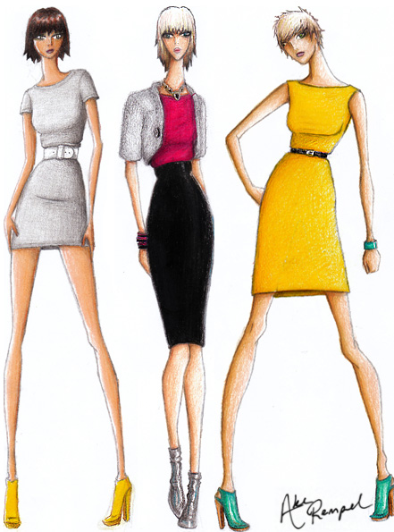
Dressing cont’d.
You are a student and should dress accordingly and be groomed.
What not to wear to the work place at Grambling State University?

Slide 47
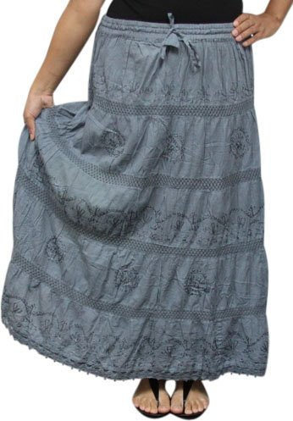
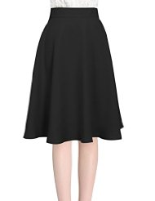
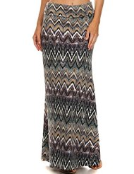
Dressing cont’d.
skirts

Slide 48
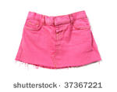
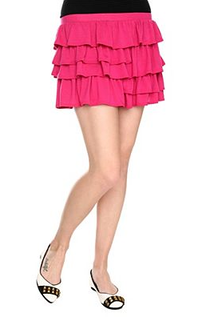
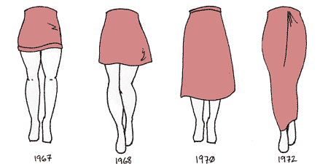
Dressing cont’d.
No mini skirts.

Slide 49
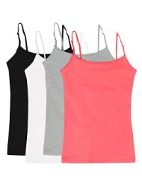
Dressing cont’d.
Tops – No spaghetti straps.

Slide 50
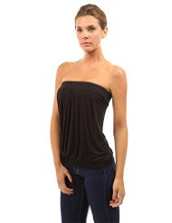
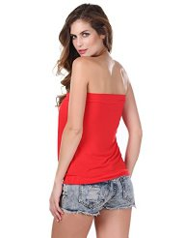
Dressing cont’d.
No strapless tops.

Slide 51
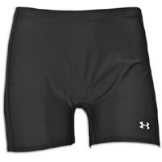
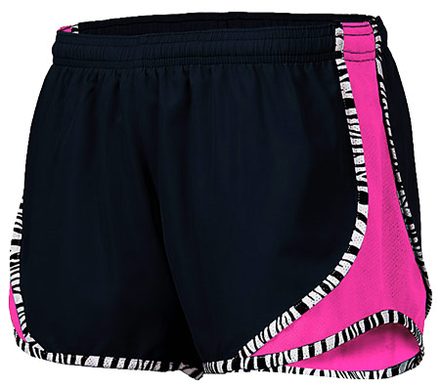
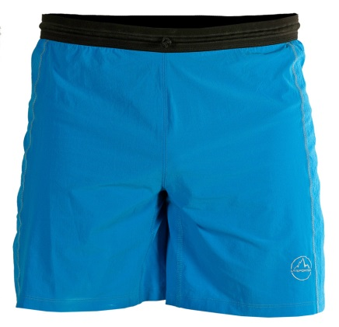
Dressing Cont’d.
No athletic shorts or shorts of any kind. Any pants should at least be to the knee in the office.

Slide 52

Dressing cont’d.
Men, no wife beater shirts or undies shirts.

Slide 53
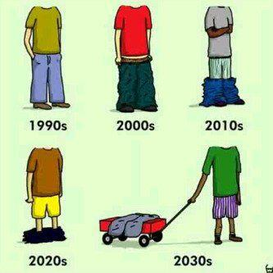
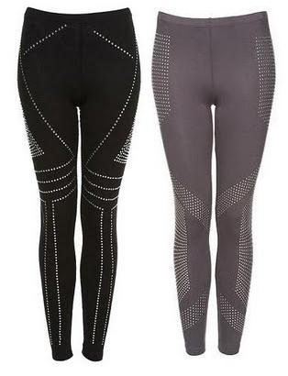
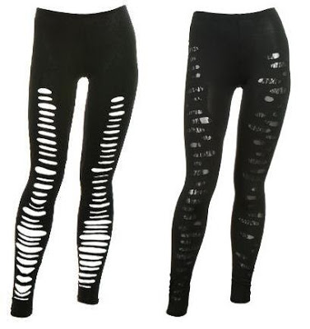
Dressing cont’d.
No sagging pants. No leggings without a long shirt that goes below the behind.

Slide 54
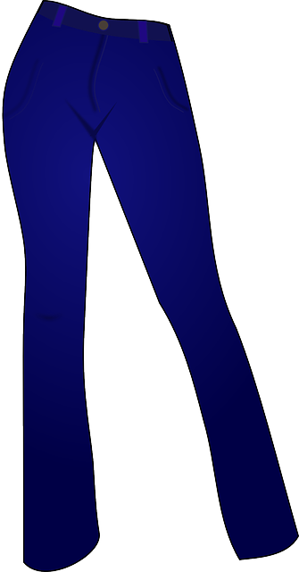


Dressing cont’d.
No breast or chest exposed.
Shoes – No flip flops!
No stomach’s exposed.
What should be worn to work?
Slacks, jeans(none with holes), or any pants .

Slide 55
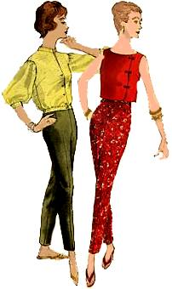
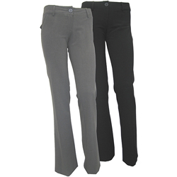
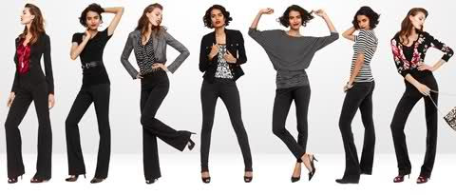
Dressing cont’d.
Slacks

Slide 56
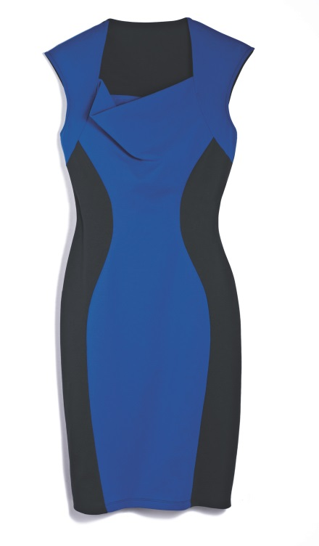
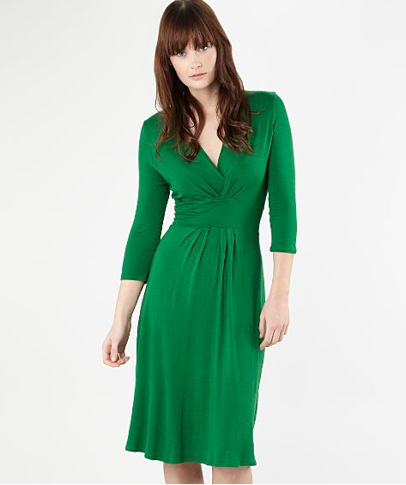
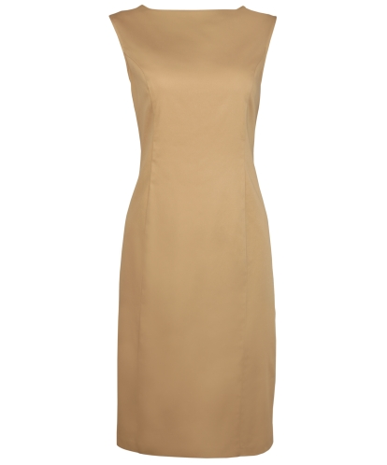
Dressing cont’d.
Dresses/skirts are great if the correct length.

Slide 57


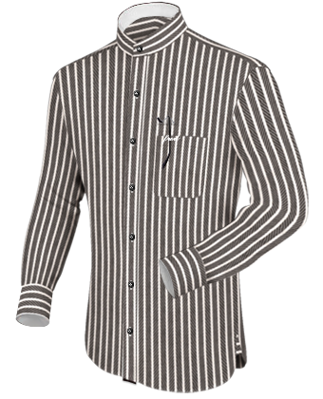
Dressing cont’d.
Tops/shirts( No shirts tails or t-shirts hanging out of pants) - Men

Slide 58
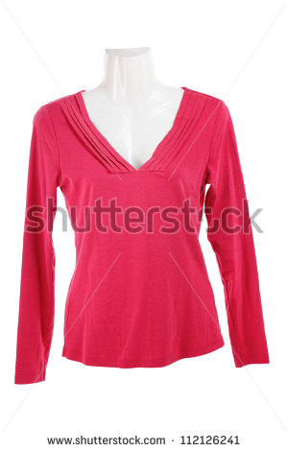
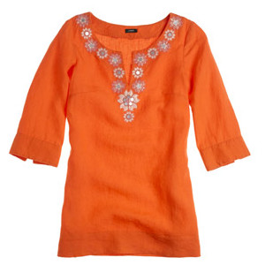
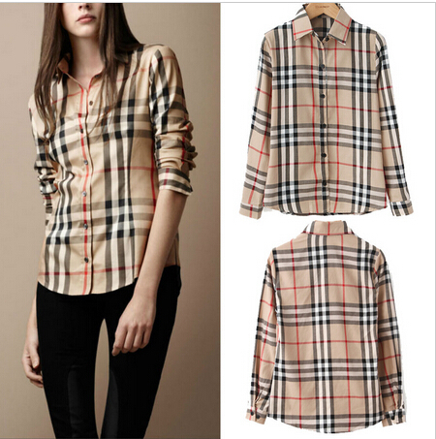
Dressing cont’d.

Slide 59
Dressing cont’d
Shoe requirements may vary due to safety. The these are the basic requirements for shoes, which is not flip flops or slippers. (male or females)

Slide 60
Ethical Behavior in the Workplace
First and foremost, take care of YOURSELF.
You are totally accountable for your actions in the business world.
Do not confuse character with compromise. If it is absolutely necessary to do something questionable, then safeguard yourself with documentation. You should NEVER compromise your personal morals and values.
You must act in your Department’s best interest.
Each office must have 3 chief characteristics:
Conscience – This is a shared understanding and agreement of standards or acceptable and unacceptable behavior. This is done by developing an agreed upon and documented cod of ethics and conduct.

Slide 61
Ethical Behavior cont’d.
These values should be a living part of the culture, inspiring employees to change their behavior to conform.
Commitment – Workers must hold themselves responsible and accountable to uphold standards.
Communication – There should be an ongoing discussion about ethical issues that promotes trust and fairness.
Do ethical standards change with age? Yes, it is an extension of childhood. If some lied when they were a child, they will continue to do so as an adult.

Slide 62
Ethical Behavior cont’d.
When there is a conflict between a junior and senior staff member, the best way to deal with that is to maintain mutual respect; with respect comes trust.
When a department is unethical, there is a revolving door. Employees keep leaving which is costly.
What is important is that a department should create an environment promoting strong ethics, where discussing the ethical dimension is a part of what it means to manage well.

Slide 63
Ethical Behavior cont’d.
These are a list of Good Work Ethics that a worker should have:
Reliability – A reliable employee is punctual, follows through on his tasks and shows up ready to work. If an employee consistently arrives late to work and fails to follow through or complete his tasks, the department loses time.
Positive, Helpful Character – Workers should have a positive attitude and be willing to help each other out. Negativity and dissent can spread like a disease and damage the morale and productivity. Workers should show initiative to make themselves useful and act as teammates to one another.

Slide 64
Ethical Behavior cont’d.
Proper communication –Strong interpersonal skills can help form cohesive teams among workers and make handling challenges easier. Workers must communicate effectively and understand the difference between constructive criticism and destructive griping. Strong interpersonal skills involve understanding a little about office politics –The worker should know when to speak up and when to listen.
Goal-Oriented – While receiving a paycheck is a strong motivator, a good work ethic is putting yourself aside to work toward the greater good of the company as a whole. Work on team-building, show respect to your employees, but also be stern when necessary.

Slide 65
Quick Tips
Always be willing to learn a new task. Versatility goes a long way.
Ask co-workers if they need help with anything, Better to make friends by helping than enemies by complaining.
Remember who signs your paycheck and respect them at all times.
Write messages in a duplicate book and give one copy to the person the message is for. Or use a diary, which is easier to refer back to especially to recall a name or number.
Keep personal business away from your area – this includes cell phone calls and emails. IT departments can and will screen computer activities.

